Slide 1
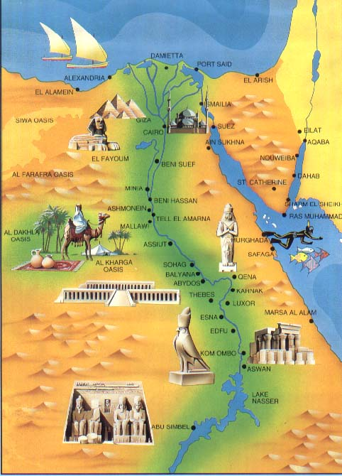
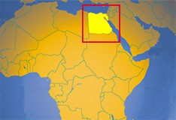
Ancient Egypt Vocabulary

Slide 2
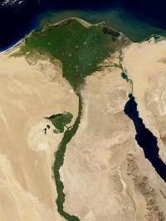
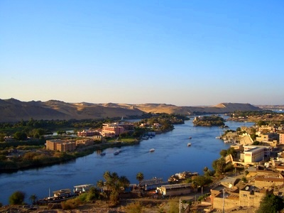
Nile River
The longest river in the world. The lifeblood of Ancient Egypt.

Slide 3
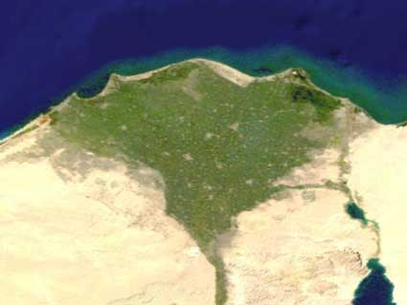
Delta
A triangle shaped area of land made of soil deposited by a river

Slide 4
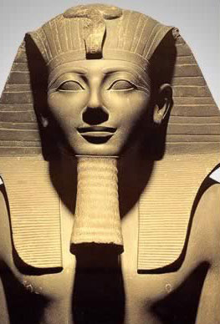
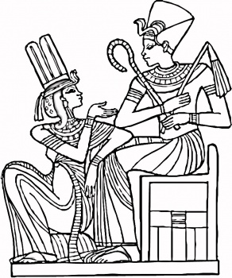
Pharaoh
The title used by the rulers of Egypt, means “Great House”

Slide 5
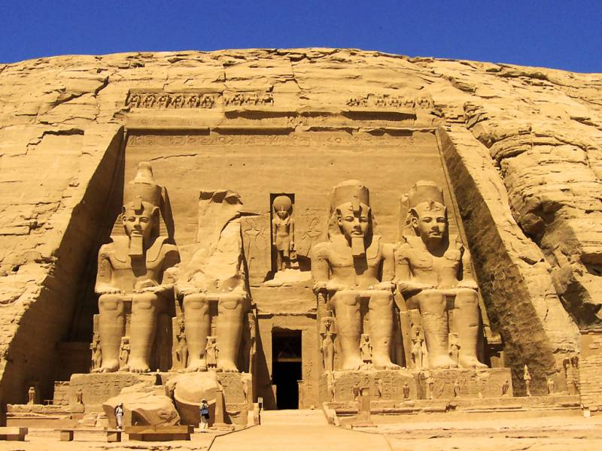
Dynasty
A series of rulers from the same family

Slide 6
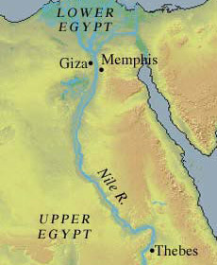
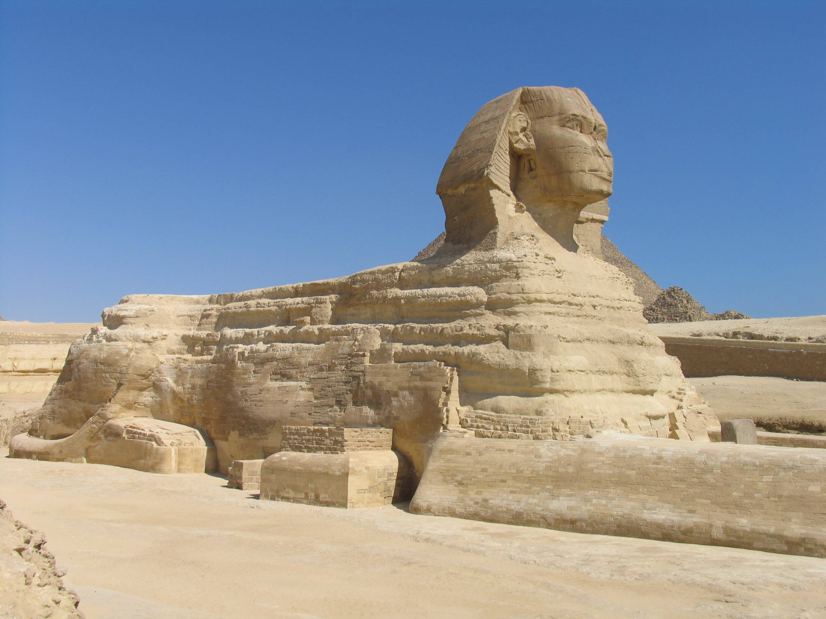
Old Kingdom
A period of Egyptian history that lasted from 2700 BC- 2200 BC when Egypt attained its first continuous peak of civilization in complexity and achievement

Slide 7
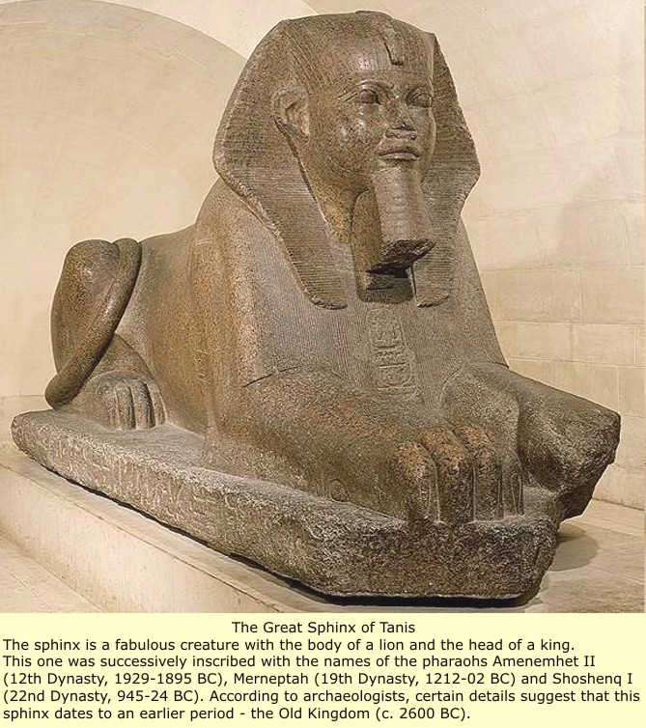
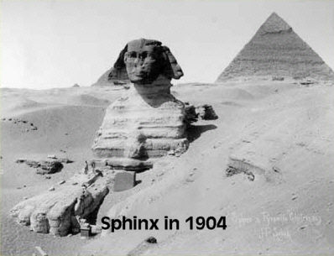
Sphinxes
Imaginary creatures with the bodies of lions and the heads of other animals or humans

Slide 8
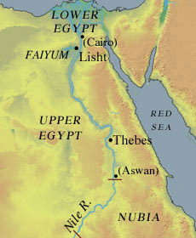
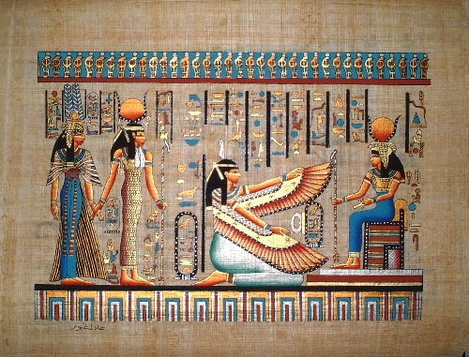
Middle Kingdom
A period of order and stability that lasted until about 1750 BC noted by the reuniting of Upper and Lower Egypt, setting the stage for a second great flowering of Egyptian culture

Slide 9
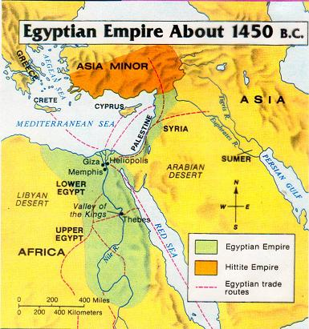
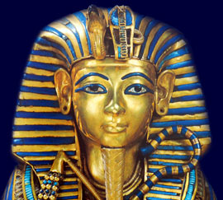
New Kingdom
The period during which Egypt reached the height of its power and glory.. with which most of us are familiar because of the famous Pharaohs who reigned during this era including King Tut.

Slide 10
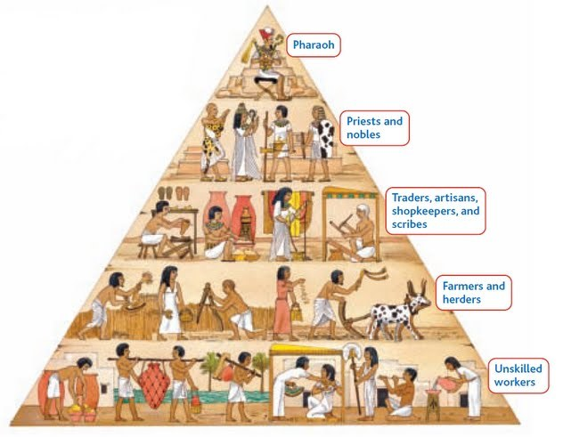
Nobles
People from rich or powerful families

Slide 11
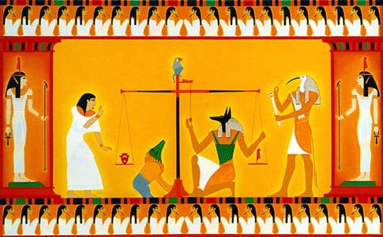
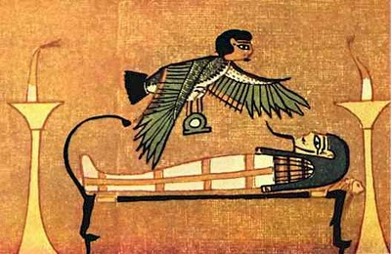
Afterlife
An important part of Egyptian religion…it was the continued life of one’s soul after death

Slide 12
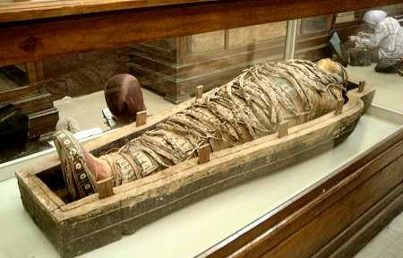
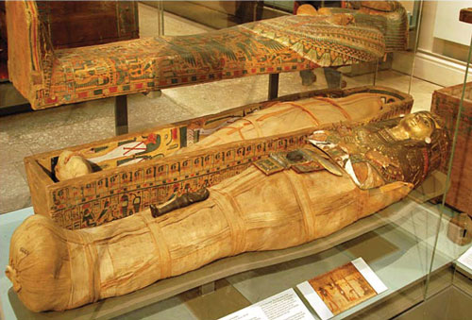
Mummies
Special treated (preserved) bodies wrapped in cloth so they could use them in the afterlife.

Slide 13
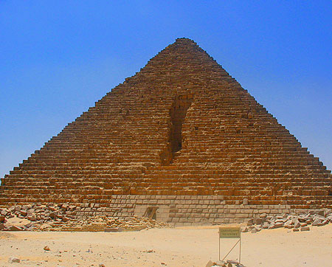
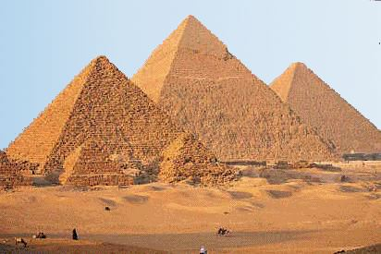
Pyramids
Large stone pointed structure with four triangle walls that met in a point on top…built as tombs for the pharaohs and their queens

Slide 14
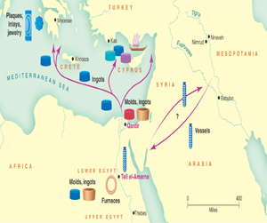
Trade Routes
Paths followed by traders by land and water

Slide 15
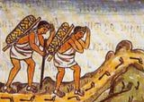
Trade Network
A system of people in different lands who trade goods

Slide 16
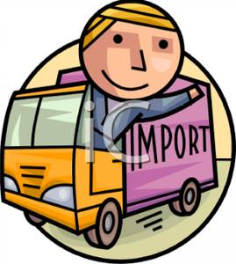
Import
Goods brought In to your area by other regions

Slide 17
Export
Goods that Exit your area to other regions

Slide 18
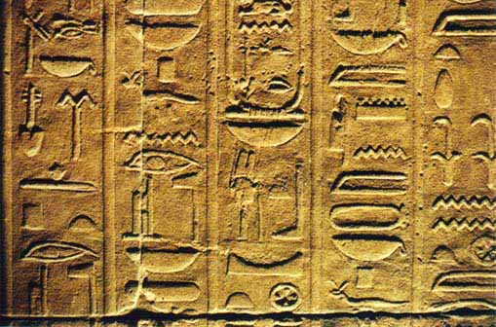
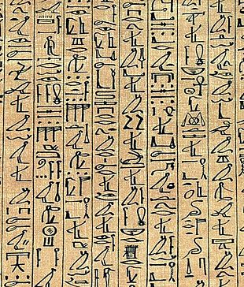
Hieroglyphics
The Ancient Egyptian writing system

Slide 19
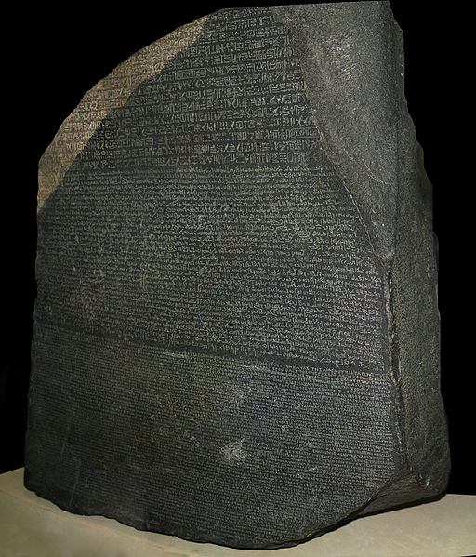
Rosetta Stone
A stone slab inscribed with hieroglyphics that provided the key to the modern understanding of Egyptian hieroglyphs.

