Slide 1
The Early Humans
Unit 2

Slide 2
early man
A. Understanding Important Terms in the Science of searching for Human Origins
1. prehistory – before human’s began recording past events
2. archaeologists – scientists who learn about early humans by excavating and studying the traces of early human settlements.
3. artifacts – remains such as tools, jewelry, and other human-made objects.
culture – a people’s unique way of life.
-ology = the study of
Archae = old things

Slide 3
Early man
Fossils are remains of living things (plants, animals, people), not of things that were made.
Artifacts are remains of things that were made, not the remains of living things.

Slide 4
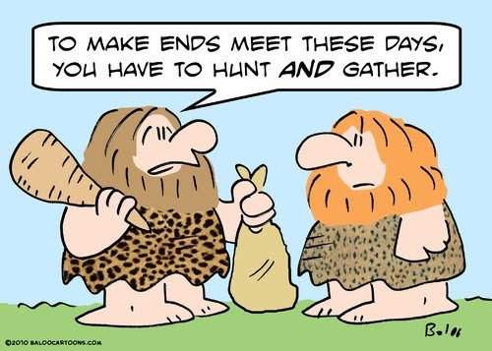
archaeology site
A "site" is a place archaeologists wish to explore.
How do archaeologists find sites to explore?
1. They think about what people need to stay alive. Some of those things include access to clean drinking water, a protected place to live, and easy access to trade routes. With this in mind, archaeologists look for remains of civilizations along the banks of rivers and streams.

Slide 5
first man
3 million years ago, our planet was teeming with life!
It was during this time that the higher primates, including apes and early man, first appeared.
There was a difference between apes and man. Early human-like hominids could stand upright. Apes could not.

Slide 6
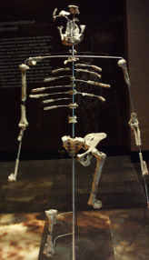
lucy
In 1974, a skeleton was found in Africa. The bones were those of a female, about 20 years old or so when she died. Scientists named her Lucy. About 3 million years ago, when Lucy was alive, she was about 4 feet tall and weighed about 50 pounds. Scientists suspect that she fell into a lake or river and drowned.
Scientists are like detectives. They can tell a great deal from a skeleton.

Slide 7
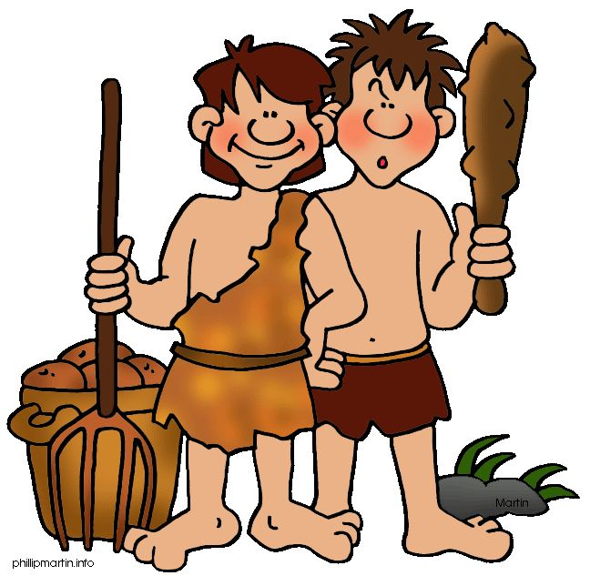
man leaves home
About one million years ago, Upright Man began to slowly leave Africa. These early people began to populate the world.
They did not need a boat. The Ice Age was here! They traveled across giant walkways of frozen ice, over what later would become vast rivers and seas.
Scientists have found artifacts of their tools and weapons, which help us to understand how they lived, where they went, and how they got there.

