Slide 1
Engage Middle Ages Activities

Slide 2
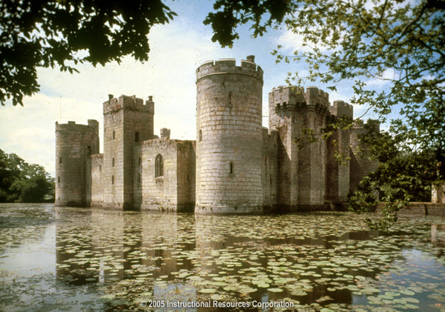
What do you think?
Describe 3 things you see in this picture.
This castle was built on a human-made lake in 1386.

Slide 3
What do you think?
Why do you think people built castles during the Middle Ages?
2. Who do you think lived inside castles?
What do you think the land around castles was used for?
4. Why do you think people stopped building castles?

Slide 4
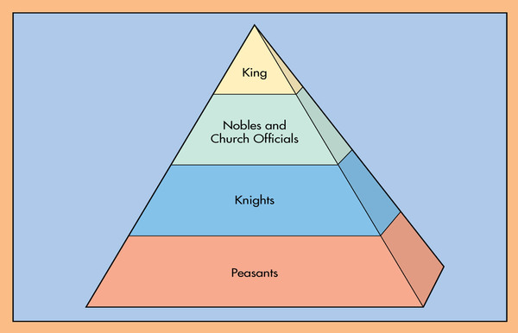
Compare/contrast to a civilization we have studied
How does a social hierarchy affect people in that civilization?

Slide 5
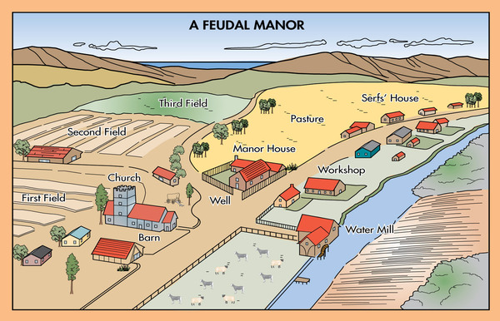
What do you think?

Slide 6
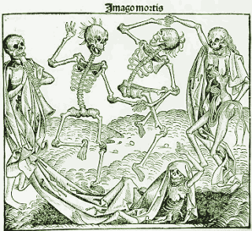
Describe 5 things that are happening in this picture.

Slide 7
Exit Ticket
What does this picture indicate about life during the Plague?
People believed death was a time for celebration.
People felt there was nothing enjoyable about life.
People feared that ghosts had power haunt them.
People treated death as a common part of society

