Slide 2
I can answer questions about the setting of the novel Esperanza Rising based on evidence from the text.
I can answer questions about the main character, Esperanza, based on evidence from the text.
Notes:
What do they notice? Briefly review the terms setting (from Lesson 1) and character to support students in understanding the targets. Remind the class that Esperanza Rising is historical fiction: The author draws upon real events, real settings, and some real people, but also made up many events and characters.
Remind the students of what they learned about yesterday (Mexico, the Mexican Revolution, social unrest), and ask them to turn and tell a neighbor where Esperanza Rising takes place (the setting: Aguascalientes, Mexico) and what characters have been introduced so far (Esperanza and her papa).

Slide 3
What is it like where Esperanza lives? Use details from the text to support your answer.
What is Esperanza’s relationship with her papa like? How do you know?”
Notes:
Check to see that everyone in the class has their text: Esperanza Rising. Make sure each student has his/her baggie of evidence flags. Remind everybody that they will be using these sticky notes throughout the novel to help them keep track of important passages.
Tell students that they did a “first draft” read of Chapter 2: “Las Uvas/Grapes” for their homework. Point out that this novel is challenging, and that they will often need to read sections multiple times in order to understand the ideas in the text. Explain to students that the most important thing to do while reading is to think! Say: “As we read this book, we are going to be thinking a lot about the characters—what they are like, the challenges they face (including human rights), and how they change over time.”

Slide 4
Read
Page 4-6

Slide 5
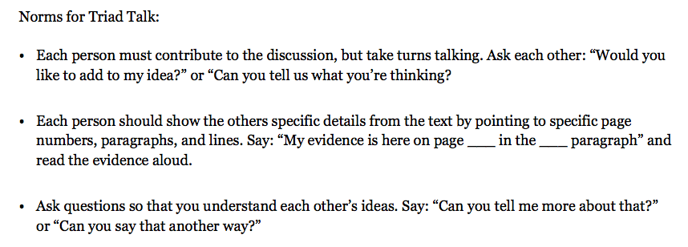
Notes:
Invite students to think, then talk briefly with their triad, about what these first few pages of Chapter 2 are mostly about. Listen for students to notice the chapter title “Las Uvas/Grapes.” If necessary, point out how chapter titles in a novel provide a signal to a reader about the main ideas or events in a given chapter.

Slide 6
Notes:
Give students five minutes on their own to reread through the break on page 8. (Note that this is the third time they have read pages 4-6). Remind them that rereading is an important strategy to help them make sense of difficult text. Ask them to keep Question 1 in mind as they read.
Ask students to use the Triad Talk anchor chart to remind themselves about how to talk to each other while developing the answer to the question in their triad. Each person should mark the evidence in the book that supports the group’s answer by placing an evidence flag on the specific information.
Ask a few groups to report out their answer and their evidence. If necessary, model by adding additional evidence to clarify and further support what students are saying.
Praise groups using Triad Talk well. Tell students that they will be working in these groups each day, and remind them how discussing their thinking with others can help them understand hard text.

Slide 7
Notes:
Distribute the Text-Dependent Questions for Chapter 2: Las Uvas/”Grapes” to students. Focus them on the second question. Tell them to listen for and mark evidence that answers the question as you read aloud. Continue to read aloud from the middle of page 8, with students following along. Stop at the break in the middle of page 12, and ask students to discuss their answers to Question 2 with their triad, rereading the pages if necessary. Again, follow the process of having some triads report out their answers to the class, augmenting the students’ responses with evidence from the text if necessary.
Note: Students may not have time to answer all three of the remaining text-dependent questions; Question 5 (about Papa’s death) is revisited in Lesson 3.
In triads, students should read aloud one text-dependent question at a time, and clarify any terms. They should then think on their own, then talk together to answer the question, marking their answers with evidence flags. They do not need to write answers to the questions at this point.
Students should then repeat this cycle for the next question.
As students work, monitor this discussion, making sure all students are participating. Reinforce students who are following the Triad Talk norms well.

