Slide 1
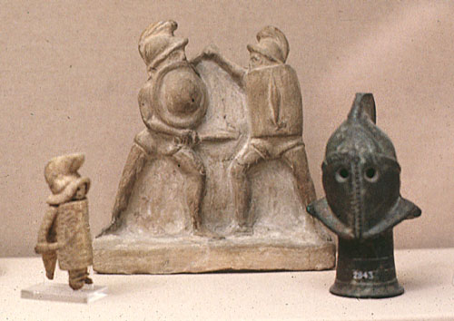
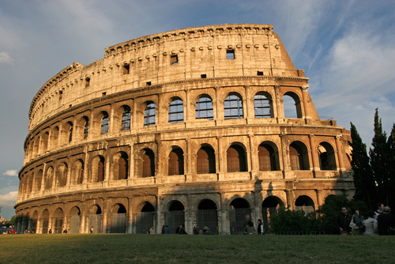
Ancient Rome: Gladiators

Slide 2
Facts about Gladiators
Roman gladiators were trained in mortal combat,
a form of public entertainment in ancient Rome.
Roman gladiators were usually convicted
criminals, slaves, or prisoners of war.
Many gladiators came from the lands Rome had
conquered.
Women could not be gladiators.

Slide 3
Gladiators were supposed to fight to the death, but if they fought extremely well the crowd could decide to spare both fighters
At a large event there could be hundreds of gladiators. In the Coliseum, the audience could be as large as 50,000 people.
Some gladiators who managed to survive the fierce fighting became famous or even wealthy.
As Christianity spread and the power of the Roman Empire declined, the appeal of the games diminished.

Slide 4
Imagine you are a Gladiator…
A top Roman magazine, “Gladiator’s Today,” sent you a questionnaire to fill out.
Answer the questions in complete sentences to let the world know what it is really like to be a gladiator!
Be creative and informative—give as much information as possible.

