Slide 1
Types of Governments
Grade 7
Social Studies Online Presentation

Slide 2
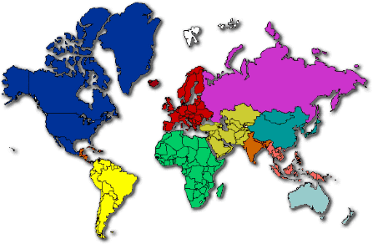
Blueprint Skill: Governance & Civics Grade 7
Define the different types of governments (i.e., democracy, autocracy, oligarchy, monarchy, and dictatorship).

Slide 3
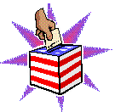
Democracy
In a democracy, the government is elected by the people. Everyone who is eligible to vote has a chance to have their say over who runs the country. It is distinct from governments controlled by a particular social class or group (aristocracy; oligarchy) or by a single person (despotism; dictatorship; monarchy).
A democracy is determined either directly or through elected representatives.

Slide 4
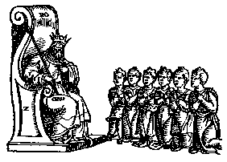
Autocracy
Government by a single person having unlimited power; despotism (domination through threat of punishment and violence) .

Slide 5
Oligarchy
A government in which a few people such as a dominant clan or clique have power.

Slide 6
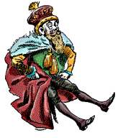
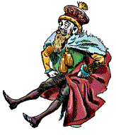
Monarchy
A monarchy has a king, queen, emperor or empress.
The ruling position can be passed on to the ruler’s heirs.
In some traditional monarchies, the monarch has absolute power.
But a constitutional monarchy, like the UK, also has a democratic government that limits the monarch's control.

Slide 7
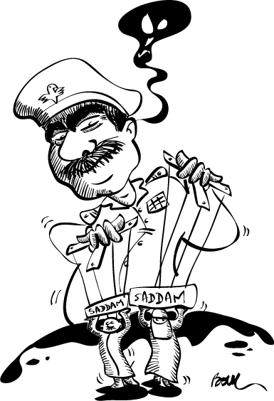
Dictatorship
A country ruled by a single leader. The leader has not been elected and may use force to keep control.
In a military dictatorship, the army is in control.

Slide 8
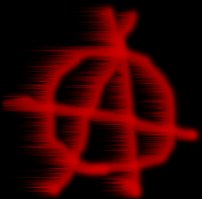
Anarchy
Anarchy is a situation where there is no government. This can happen after a civil war in a country, when a government has been destroyed and rival groups are fighting to take its place.
Anarchists are people who believe that government is a bad thing in that it stops people organizing their own lives.

Slide 9
Capitalist
In a capitalist or free-market country, people can own their own businesses and property. People can also buy services for private use, such as healthcare.
But most capitalist governments also provide their own education, health and welfare services.

Slide 10
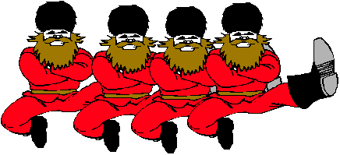
Communist
In a communist country, the government owns property such as businesses and farms.
It provides its people's healthcare, education and welfare.

Slide 11
Republic
A republic is a country that has no monarch.
The head of the country is usually an elected president.

Slide 12
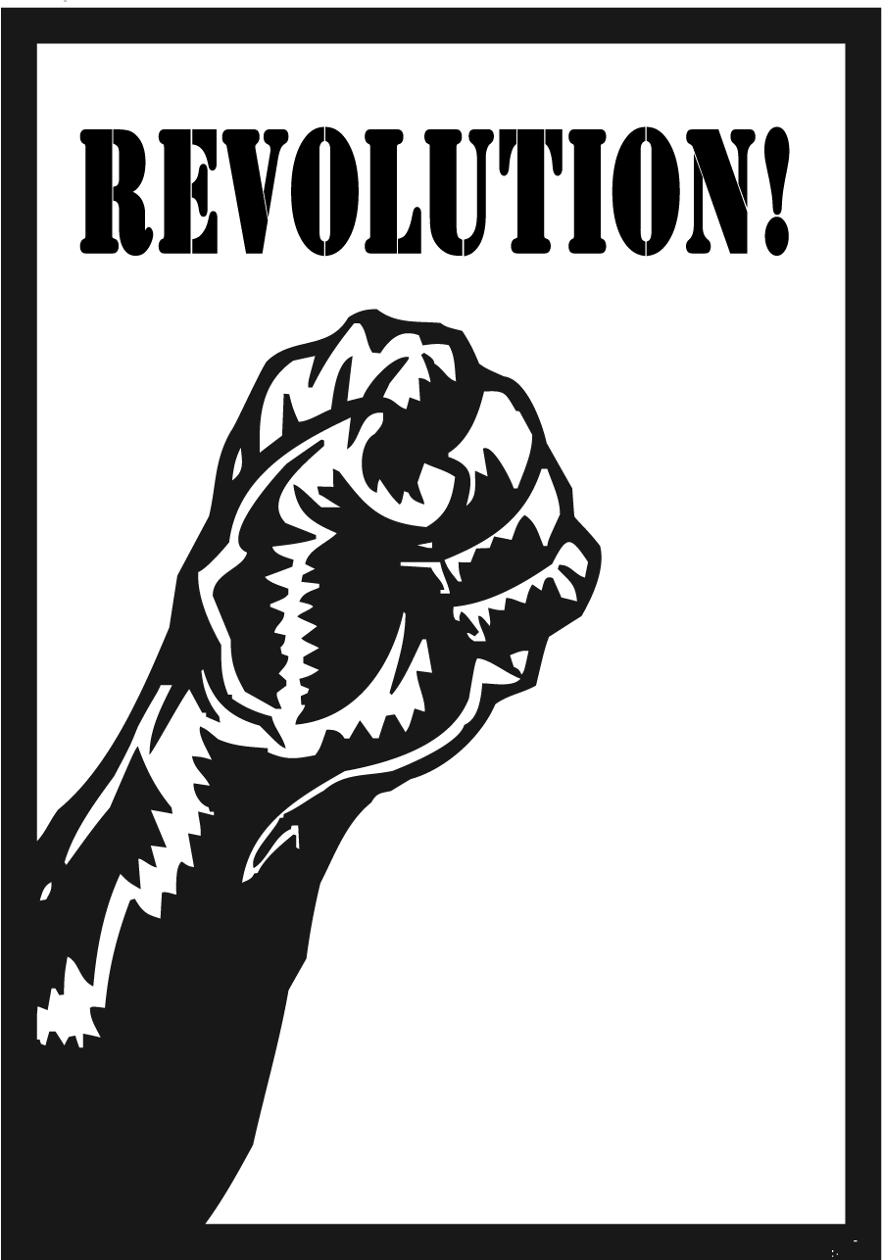
Revolutionary
If a government is overthrown by force, the new ruling group is sometimes called a revolutionary government.

Slide 13
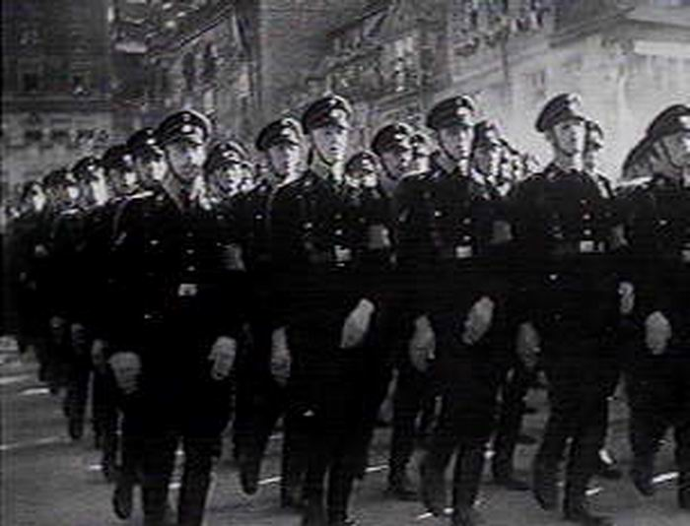
Totalitarian
This is a country with only one political party.
People are forced to do what the government tells them and may also be prevented from leaving the country.

Slide 14
Ready for a quiz?
Play
Government
Squares

Slide 15
Inspired by
A Game of X’s and O’s

Slide 16
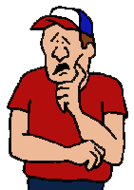
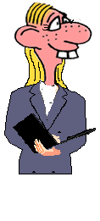
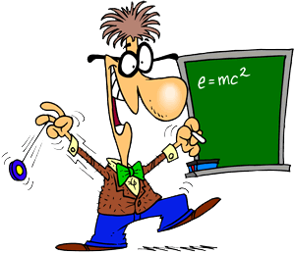
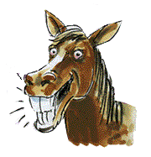
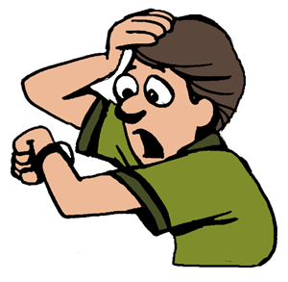
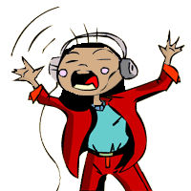
1
2
3
4
5
5
6
7
8
9

Slide 17
1
2
3
Scoreboard
X
4
5
6
O
7
8
9
Click Here if
X Wins
Click Here if
O Wins

Slide 18
1
This form of government is elected by the people and everyone is eligible to vote.

Slide 19
1
Democracy
Home

Slide 20
2
A government ruled by a king, queen, emperor or empress.

Slide 21
2
Monarchy
Home

Slide 22
3
A country ruled by a single leader. The leader has not been elected and may use force to keep control.

Slide 23
3
Dictatorship
Home

Slide 24
4
Government by a single person having unlimited power; despotism (domination through threat of punishment and violence).

Slide 25
4
Autocracy
Home

Slide 26
5
The government owns property such as businesses and farms and provides its people's healthcare, education and welfare.

Slide 27
5
Communism
Home

Slide 28
6
A situation where there is no government.

Slide 29
6
Anarchy
Home

Slide 30
7
The ruling group that forms when a government is overthrown by force.

Slide 31
7
Revolutionary
Home

Slide 32
8
A government in which a few people such as a dominant clan or clique have power.

Slide 33
8
Oligarchy
Home

Slide 34
9
A country that has no monarch, but is headed by an elected president or official is a ________.

Slide 35
9
Republic
Home

Slide 38
Resources
The Democracy Project
BBC Types of Government
World Population Under Various Governments
Dictator for A Day
Types of Governments

