Slide 1
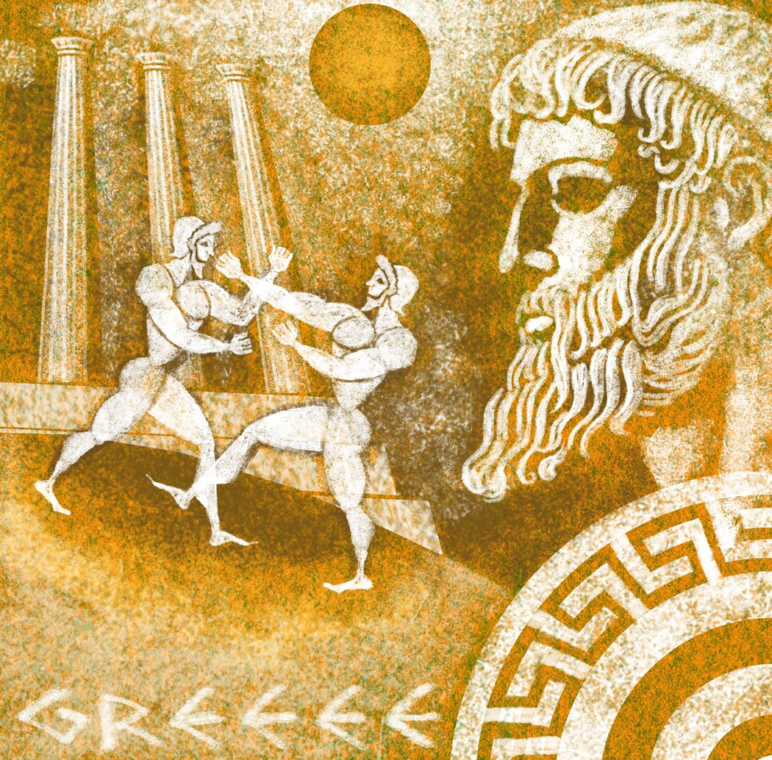

Slide 2
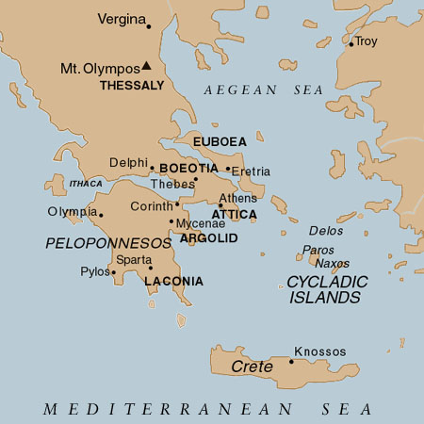
Ancient Greece Visual Vocab

Slide 3
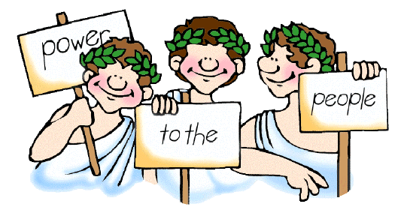
Democracy
A government in which the citizens make political decisions by voting.

Slide 4
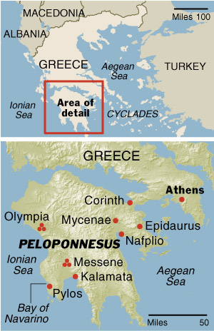
Peloponnesus
(Pel·o·po·knee·sus)
The peninsula in Southern Greece where Sparta was located.

Slide 5
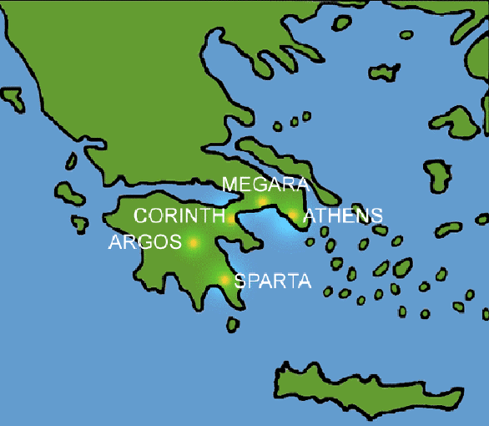
City-state
A political unit made up of a city and its surrounding lands.

Slide 6
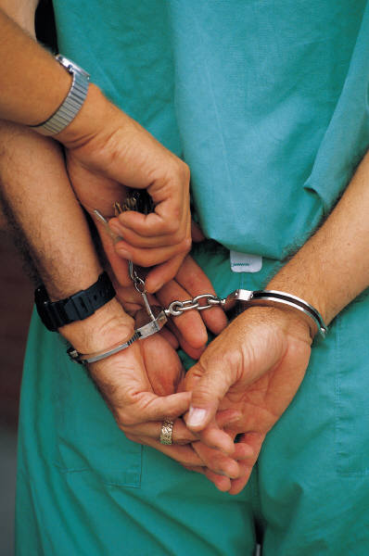
Tyrant
Someone who takes power illegally.

Slide 7
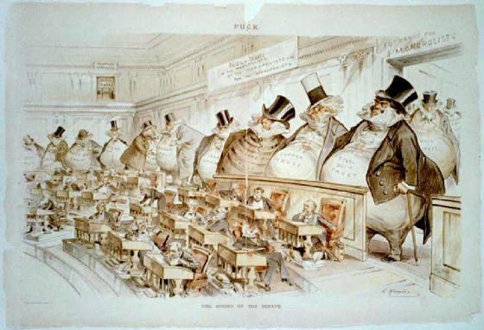
Oligarchy
A government ruled by a few powerful individuals.

Slide 8
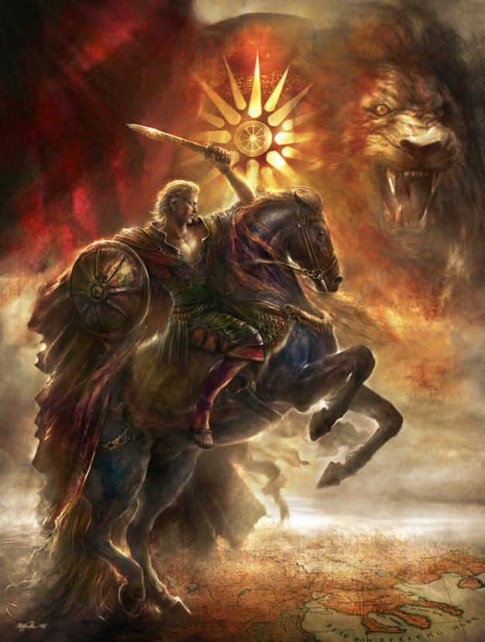
Alexander the Great
The leader of Greece. He is known for conquering land and spreading Greek Culture to all the land.

Slide 9
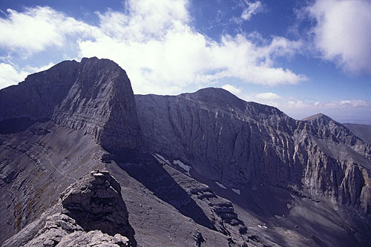

Mount Olympus
A mountain peak in NE Greece, near the Aegean coast. Believed to be the dwelling place of Greek gods.

Slide 10
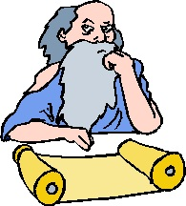
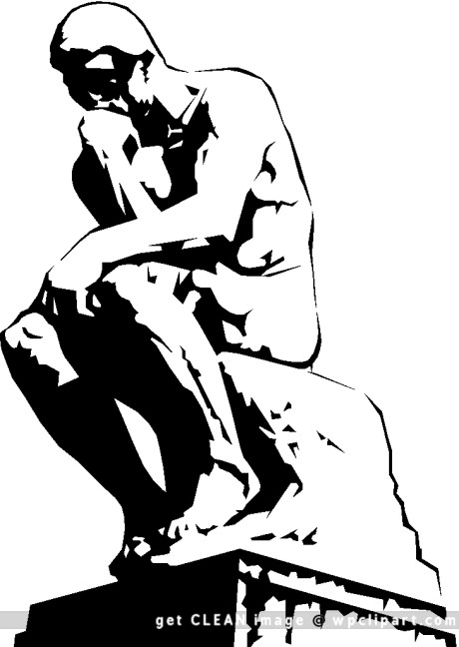
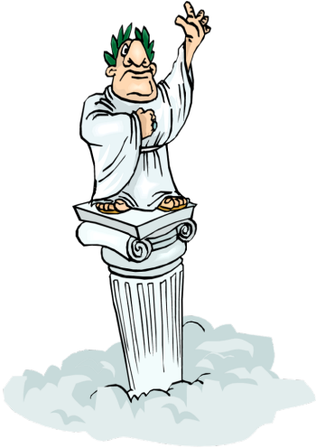
Philosopher
a person who offers views or theories on profound questions in ethics

Slide 11
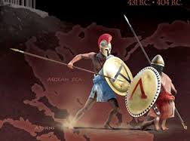
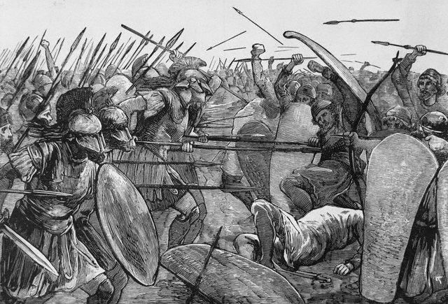
Peloponnesian War
A war between Athens and Sparta that threatened to tear all of Greece apart.

Slide 12
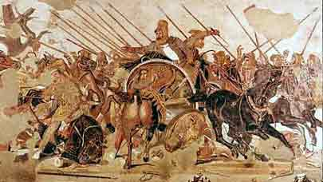
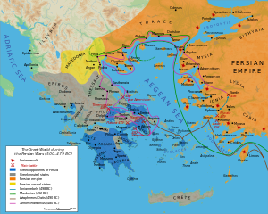
Persian Wars
The invasion by Persia began a series of wars between Persia and Greece

Slide 13
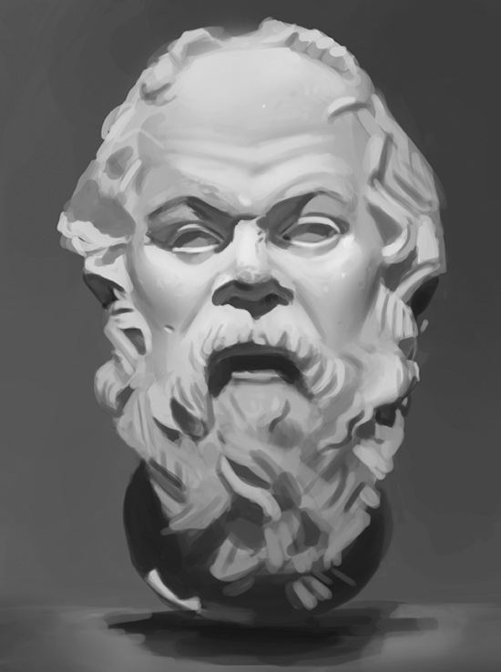
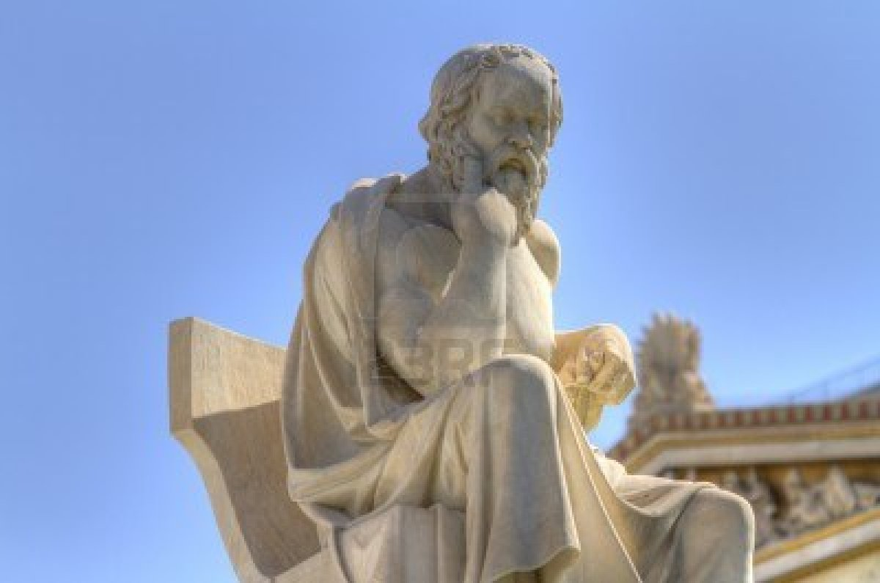
Socrates
(SOCK-ra-tees)
Greek philosopher who practiced
doubt and questioning to find the truth. Most of what is known about Socrates is from his conversations with Plato.

Slide 14
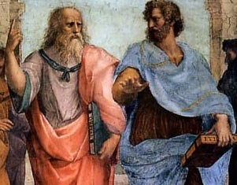
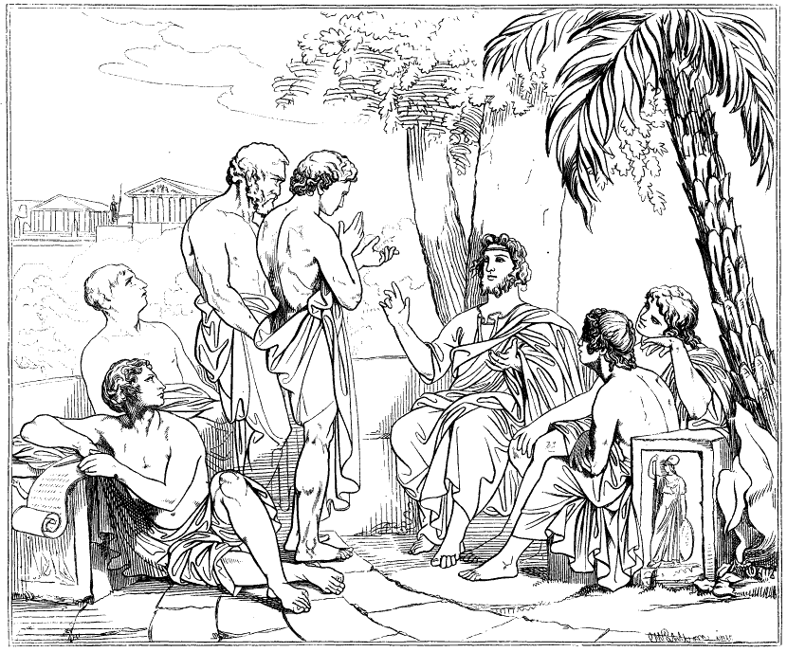
Plato
(Play-Toe)
A Greek philosopher, student of Socrates and teacher of Aristotle. His most famous work is The Republic

Slide 15
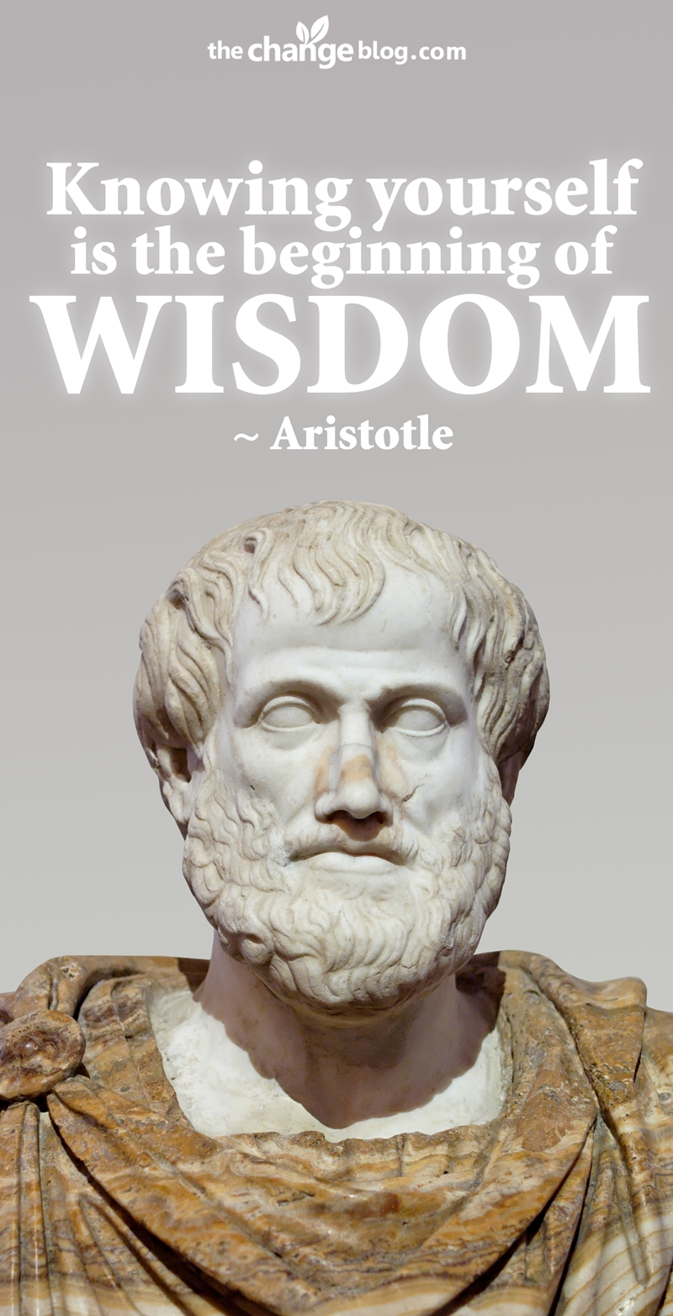
Aristotle
An ancient Greek philosopher known as the Father of Logic; student of Plato; teacher of Alexander the Great

Slide 16
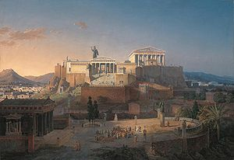
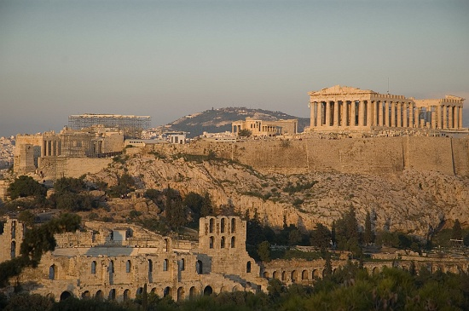
Athens
A city-state within Greece. Is known for education and philosophy.

Slide 17
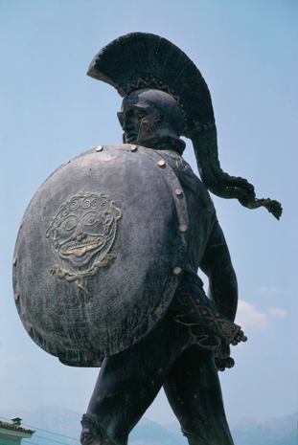
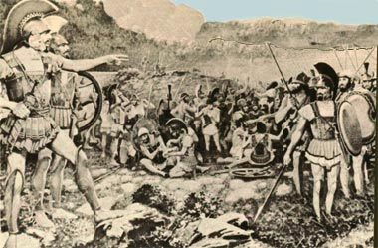
Sparta
A city-state within Greece. Is known for having a STRONG army.

Slide 18
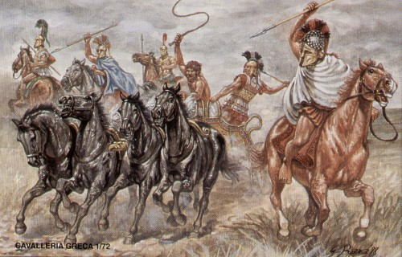
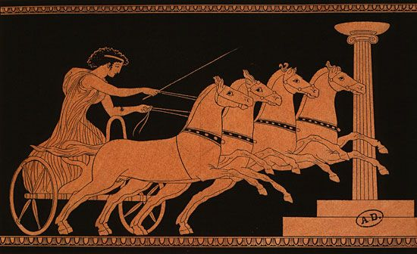
Cavalry
A unit of soldiers who ride horses

Slide 19
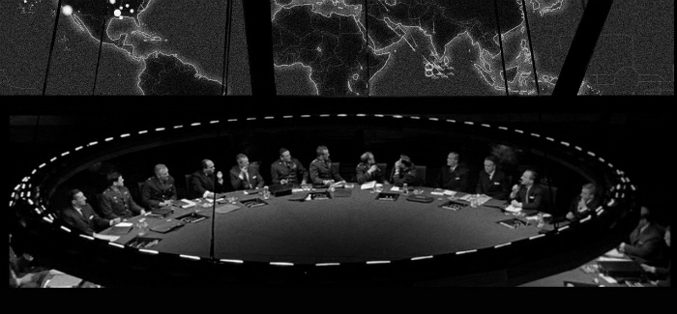
Strategy
A plan for fighting a battle or war

Slide 20
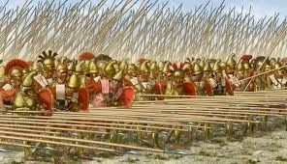
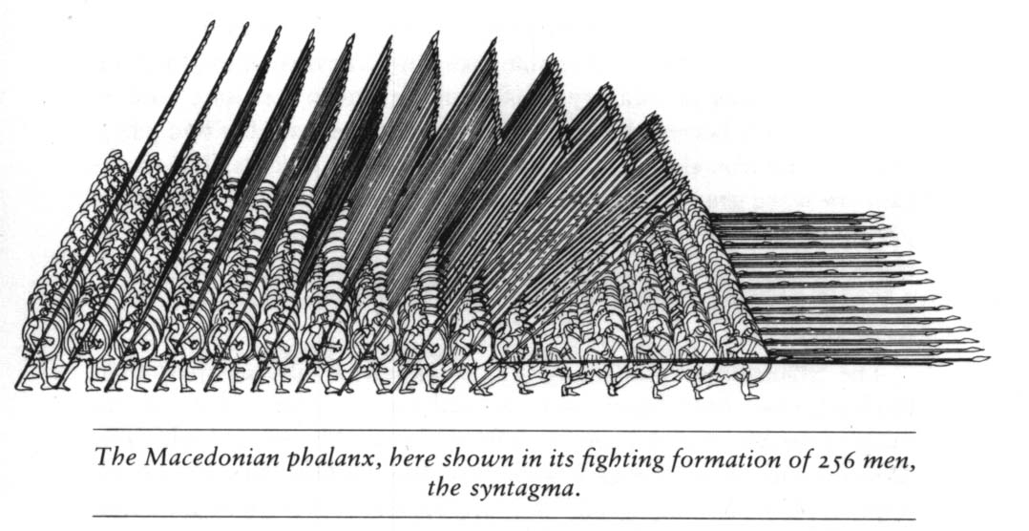
Phalanx
A group of warriors who stood close together in a square

