Slide 1
Greek Mythology
Copyright © Clara Kim 2007. All rights reserved.
Notes:
*

Slide 2
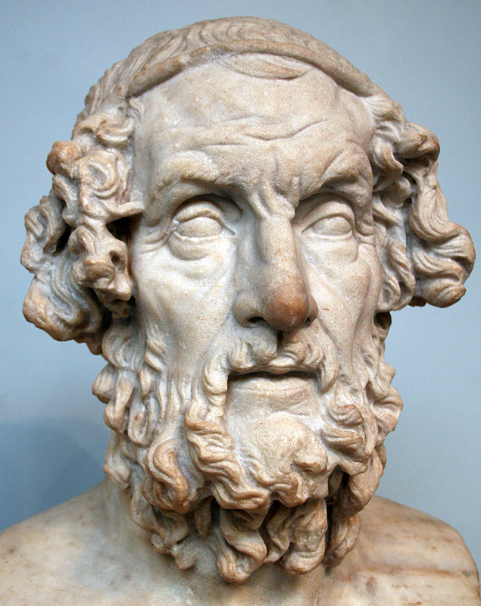
Homer
The Greeks lacked writing, so they learned about the Trojan war through spoken word
Greatest Greek story teller was a blind man named Homer.
Notes:
*

Slide 3
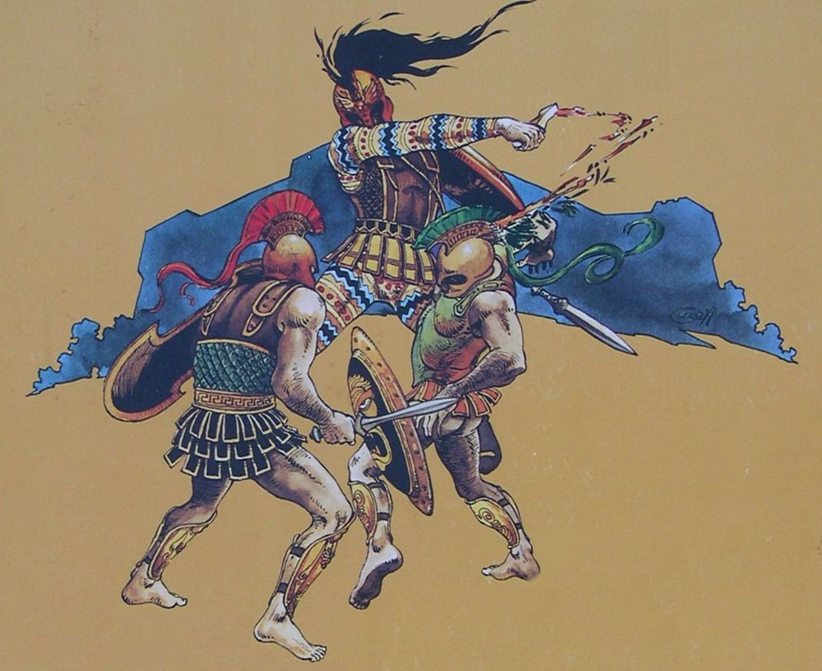
The Iliad and the Odyssey
Notes:
*

Slide 4
The Iliad and the Odyssey
Two epic poems composed by Homer about the Trojan War.
Epics – Narrative poems that tell about heroic deeds.
The heroes of The Iliad are Hector and Achilles.
The Odyssey is about a 10 year journey home of Odysseus and his adventures along the way.
Notes:
*

Slide 5
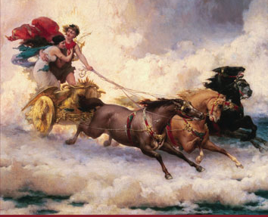
Greek Myths
Greeks developed a rich set of Myths which means traditional stories about their gods
Greeks have a polytheistic religion. This means they believed in many gods
Notes:
*

Slide 6
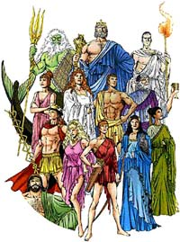
Greek Myths
Myths explained changing of the seasons and the mysteries of nature.
Greek gods/goddesses had many of the same qualities as humans:
Love
Hate
Jealousy
Greek gods competed and fought with each other constantly.
Gods lived forever on Mt. Olympus
Notes:
*

Slide 7
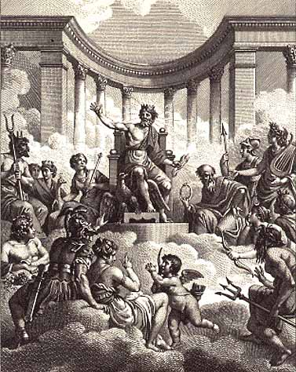
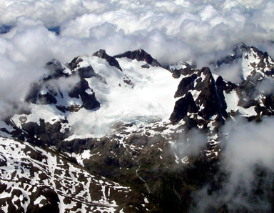
Mt. Olympus
Home of the Gods
Notes:
*

Slide 8
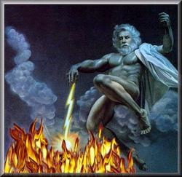
Zeus
King of the Gods
Ruler of Mt. Olympus
God of sky and thunder
Notes:
*

Slide 9
Hera
Wife of Zeus
Goddess of Marriage
Notes:
*

Slide 10
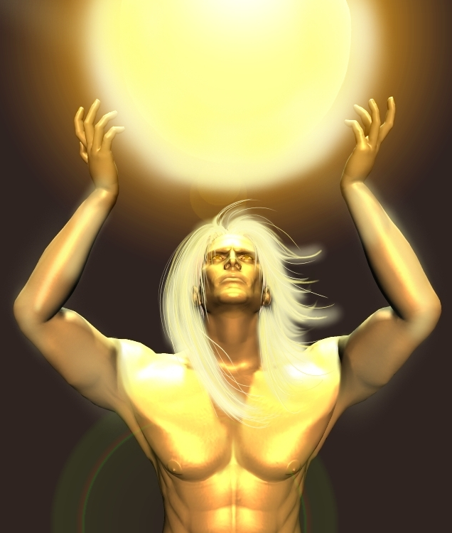
Apollo
God of medicine, healing, light and truth
Bringer of death and plague
Notes:
*

Slide 11
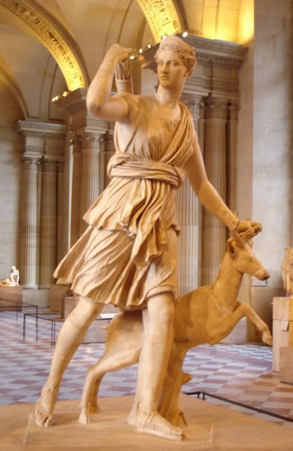
Artemis
Goddess of the hunt and bow and arrows
Twin sister of Apollo
Daughter of Zeus
Notes:
*

Slide 12
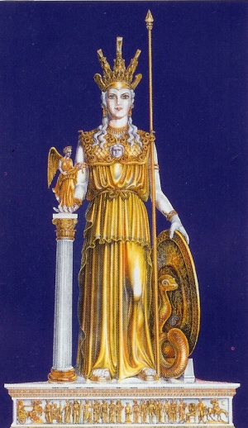
Athena
Goddess of Heroes and WISDOM
Patron Goddess of Athens
Notes:
*

Slide 13
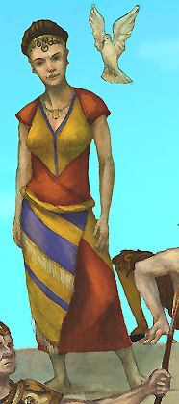
Aphrodite
Goddess of love, lust and beauty
Notes:
*

Slide 14
Pictures Cited
Slide 1 – clipart 2007
Slide 2 – http://upload.wikimedia.org/wikipedia/commons/1/1c/Homer_British_Museum.jpg, http://www.sideshowtoy.com/mas_assets/large/8501.jpg
Slide 3 – http://giochinscatola.it/catalog/images/Iliad_ITBox.jpg
Slide 5 – http://www.newvideo.com/images/boxart/AAE73096-03.jpg
Slide 6 – http://www.travel-guide-greece.com/greek-gods/ancient-greek-gods.jpg
Slide 7 – http://www.climb.mountains.com/Classic_Peaks_files/National_Park_Classics_files/Olympus_files/OlyClimb15.jpg, and www.crystalinks.com/olympians.html
Slide 8 – http://memimage.cardomain.net/member_images/4/web/736000-736999/736724_43.jpg
Slide 9 – http://theseventhvoyage.com/images/Jason%20and%20the%20Argonauts/Hera.jpg
Slide 10 – http://home.ptd.net/~denian/closeups/apollo1.jpg
Slide 11 – http://fdrouin.free.fr/photos/uncategorized/artemis.jpg
Slide 12 – http://www.diannelaramee.ca/graphics/god_goddesses/athena.jpg
Slide 13 – http://hdelboy.club.fr/aphrodite_2.jpg
Notes:
*

