Slide 1
Literary Terms
The Hunger Games

Slide 2
Characterization
An author revels a character's character traits through characterization. There are two ways an author can do this, direct and indirect characterization.

Slide 3
Direct Characterization
When an author directly states a character trait.
Example: He was nice

Slide 4
Indirect Characterization
When an author hints at a character trait.
Example: He helped her (implies that he is nice).

Slide 5
Figurative Language
A figurative comparison between two things. These comparison are not to be taken literally.

Slide 6
Simile
A comparison that uses "like" or "as"
Example: She was as delicate as an angel.

Slide 7
Metaphor
A direct comparison that doesn't use "like or "as"
Example: She was an angel.

Slide 8
Idiom
A common saying that is understood in one language but cannot literally be translated into another language. It's figurative meaning is not the same as its literal meaning.
Example: Before the actor went on stage, I told him to "break a leg."

Slide 9
Imagery
A descriptive language that appeals to one or more of the five senses: taste, touch, smell, hearing, sight.

Slide 10
Irony
Contradictions in which something that was supposed to happen is replaced with an unpredictable occurrence.

Slide 11
Dramatic Irony
When the audience knows more than a stage character on stage.

Slide 12
Situational Irony
When something happens that is completely different that the expected occurrence.
Example: The fire station burns down.

Slide 13
Verbal Irony
When something is said that is then opposite of that is meant.
Example: Your car is as clean as a trash can.

Slide 14
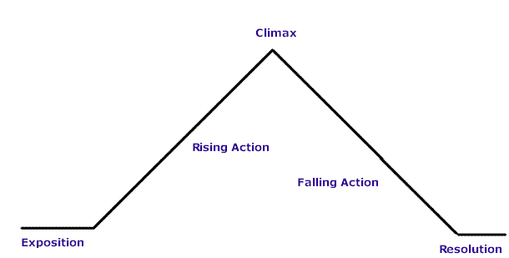
Plot
The sequence of events in a story. The plot includes the main conflict, the complications (events), the climax (the point of most tension in a story), and the resolution.

Slide 15
Point of View
The perspective from which a story is told. The most common points of view are:
First Person (using I)
Third-Person (an observer of the events)
Third-Person Omniscient (and outside observer who knows everything)

Slide 16
Theme
A universal idea that is explored in a story.
The message or moral a story is trying to teach us.

Slide 17
Tone
The emotional tome that write or narrator conveys in a story.

Slide 18
Symbols
Objects or people that can represent more that their literal interpretation.
Example: Dandelions for Katniss

