Slide 1
Name:
Date:
Unit 7
Ancient Egypt
Left= purple
Right= Black

Slide 2
Early Egyptian Life
~8,000 BC
~7,000 BC
~3,000 BC
1st human life in the area
Nomads roamed until they found the Nile river valley
Start of farming in the Nile region
Barley, wheat and vegetables grown
Many small villages established along the Nile

Slide 3
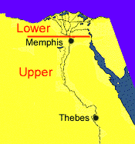
Geography
Originally two kingdoms developed along the Nile
Good farmland
Access to copper
Ruler named Menes combined the whole region through war
Lower Egypt
Upper Egypt

Slide 4
Nile River
Floods
Flows north
Ends in the Mediterranean Sea
Longest river in the world at 4,160 miles
6 Cataracts in southern part of Nile
Flooded annually in July
Floods predictable
Deposited silt, replenishing the soil with nutrients

Slide 5
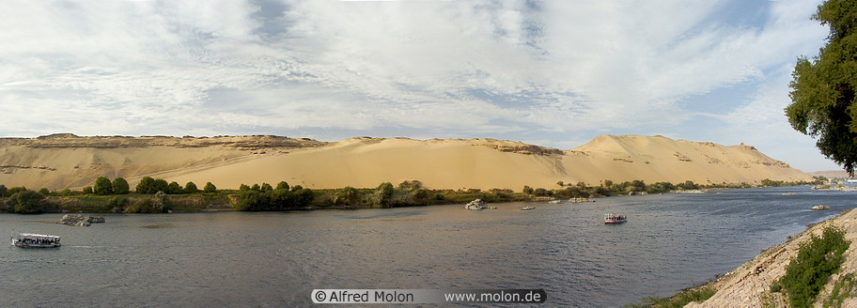
Benefits of the Nile
The river served as a highway
United villages along the river
Papyrus grew along river to make paper

Slide 6
Dynasties (ruling families)
Approximately 30 dynasties
Dynasties ruled Egypt for a total of 2700 years
Ancient Egyptian history
Old Kingdom
Middle Kingdom
New Kingdom
Three Kingdoms

Slide 7
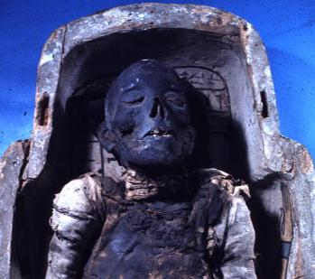
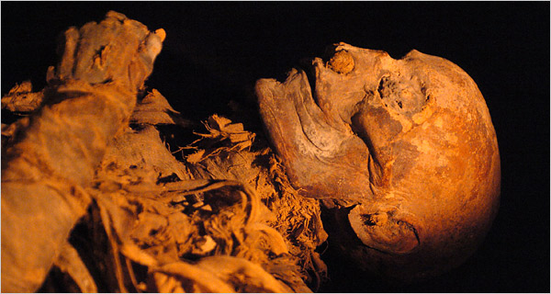
Religion
Believe in Life After Death
Polytheistic
Weighed the heart against a feather to measure the individuals life.
Preserved the bodies of the dead through mummification

Slide 8
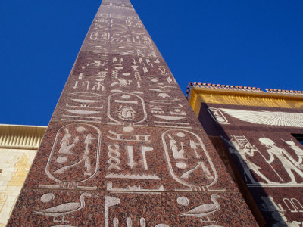
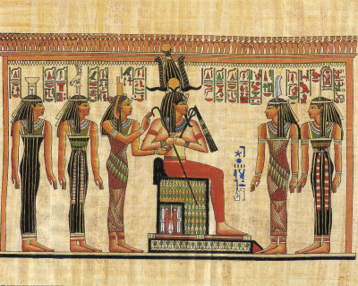
System of Writing
Symbols evolved into hieroglyphics
Writings carved in wood or stone
Later, painted with ink on papyrus

Slide 9
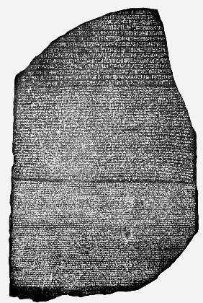
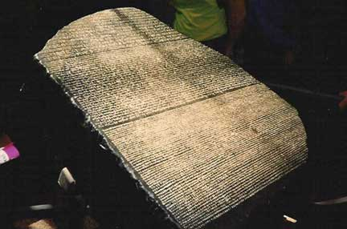
The Rosetta Stone
Slab of black rock carved in three languages
Hieroglyphics
Greek
This stone allowed hieroglyphics to be translated

Slide 10
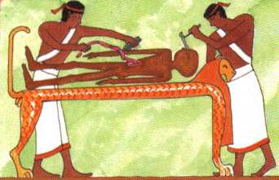
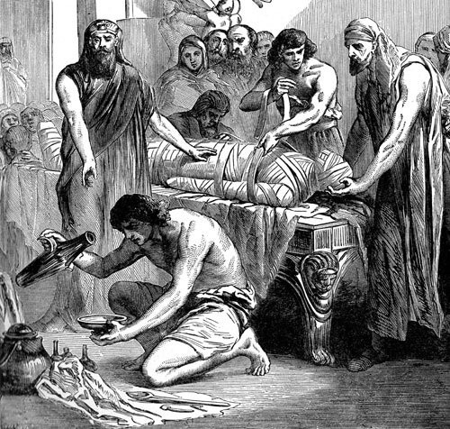
Scientific (Medical) Accomplishments
Medical discoveries
Magic heavily used
Developed surgery
Greeks & Romans based much of their medical knowledge on that of the Egyptians

Slide 11
Pharaohs organized centralized state
Corrupt government suffered frequent rebellions
Pharaohs created a large empire
Built enormous tombs, the pyramids
Irrigation systems for farming
Traded with lands along eastern Mediterranean and Red Sea
Power struggles, crop failures and cost of pyramids caused collapse
Hittites invaded and conquered
Nubians, then others invaded

