Slide 1
The Story of Ancient Greece
UNIT 3
RED=LEFT
BLUE=RIGHT
BLACK= DON’T WRITE IT
Notes:
*

Slide 2
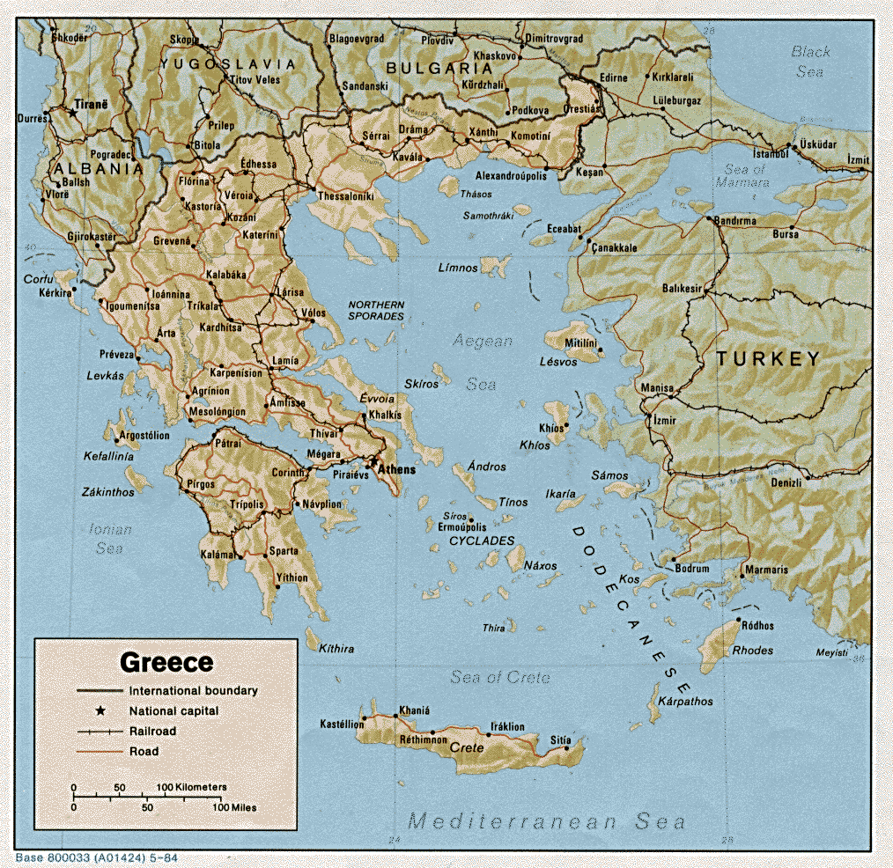
Geography of Greece
Greece is a small country in Europe.
Greece is near the Mediterranean Sea.
The main part of Greece in on a peninsula.
A peninsula is a body of land surrounded by water on three sides.
The rest of Greece is made up of islands.
Notes:
*

Slide 3
Greek City-States
Because Greece is made up of many islands, and has many tall mountains, the Greeks began to build city-states instead of one country.
A city-state is a city with its own laws, rulers, and money.
City-states were cities that acted like countries.
Notes:
*

Slide 4
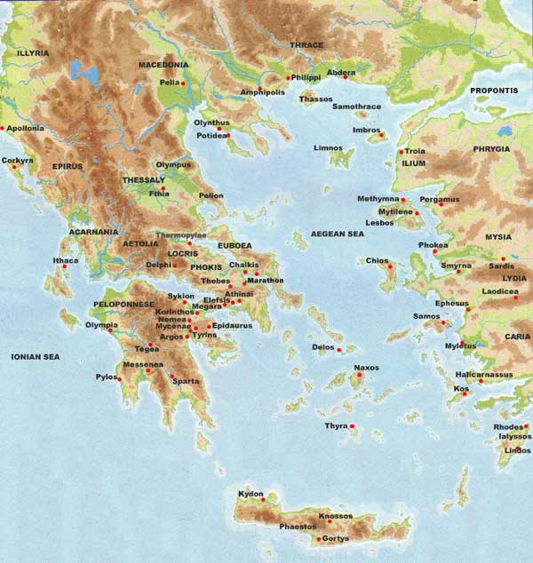
Notes:
*

Slide 5
Sparta
Sparta was a Greek city-state.
Sparta was very powerful and had its own army.
Sparta conquered other city-states to gain wealth and power.
There were three classes of people in Sparta.
Citizens, non-citizens, and slaves.
Notes:
*

Slide 6
Sparta’s Classes
Only men born in Sparta were citizens.
Women were not allowed to become citizens, but were allowed to own land and businesses. Which gave them more freedom than other Greek city-states.
The second class in Sparta was people who came from other city-states or other countries. They could own businesses but not become citizens.
The third class was slaves.
Notes:
*

Slide 7
Sparta warriors
Learning to read and write in Sparta was not very important.
Training to become a good soldiers was important.
Young boys were taken from their parents and trained to be soldiers as well as good in sports such as running.
Girls were also trained to be good in sports.
Notes:
*

Slide 8
Athens
Athens was another important Greek city-state.
The people of Athens wanted to rule themselves and not have a king or queen.
Athens became the world’s first democracy around 508 B.C.
A democracy is a government in which all citizens can vote and have equal say in what happens.
Notes:
*

Slide 9
Democracy in Athens
Athens was a democracy because all citizens could vote, but only half the people in Athens were citizens.
Women, people born outside of Athens, and slaves could not vote.
Notes:
*

Slide 10
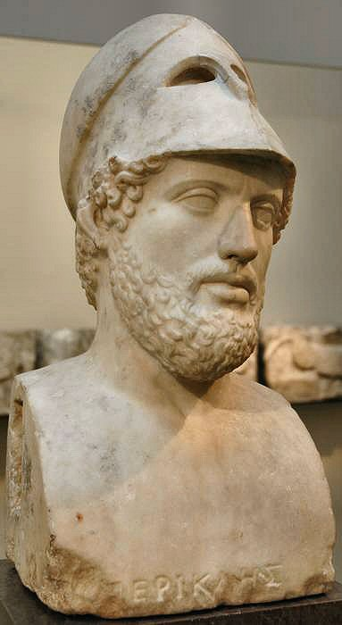
Pericles
Pericles was the leader of creating democracy in Athens.
He had many buildings constructed.
Pericles had the Parthenon and the Acropolis built.
Notes:
*

Slide 11
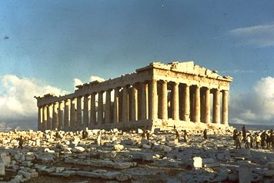
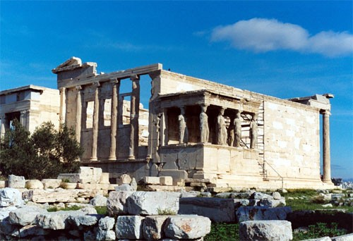
Parthenon and Acropolis
Notes:
*

Slide 12
Education in Athens
Education was very important in Athens.
Boys went to school to learn to read and write. They also learned many sports.
Girls were not allowed to go to school or learn to play sports.
Notes:
*

Slide 13
The Greek Alphabet
The Greeks borrowed their alphabet from the Phoenicians.
Most European languages, including English borrowed ideas from the Greek alphabet.
Notes:
*

Slide 14
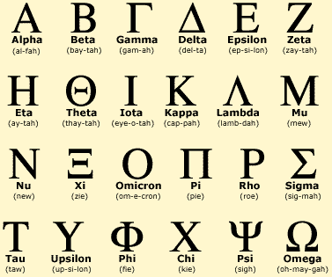
Notes:
*

Slide 15
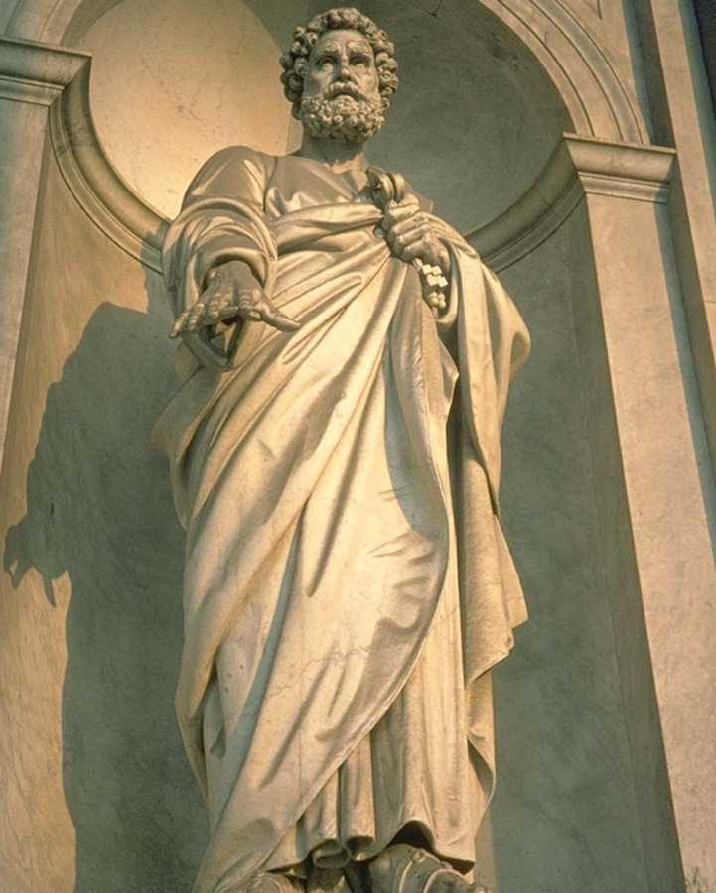
Socrates
Socrates was a philosopher of Ancient Greece.
A philosopher is someone who tries to explain the nature of life.
Socrates taught by asking questions. This method of questioning is still called the Socratic method.
Notes:
*

Slide 16
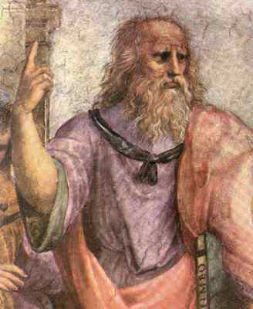
Plato
Plato was a student of Socrates.
He started a school called The Academy.
Plato’s writing took the form of a dialogue between teacher and student.
Notes:
*

Slide 17
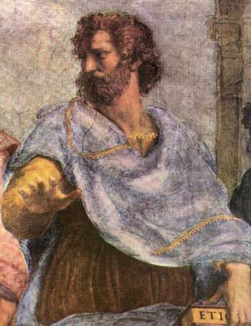
Aristotle
Aristotle was another Greek philosopher and student of Plato.
He wrote about science, art, law, poetry, and government.
Notes:
*

Slide 18
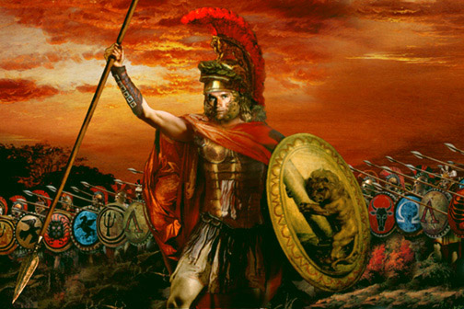
Alexander the Great
Alexander the Great was the son of King Phillip II of Macedonia.
Alexander conquered Persia, Egypt, the Middle East and Northern India.
As he conquered land he would spread Greek culture and achievements to the land and people.
He died at age 33 from malaria.
Notes:
*

Slide 19
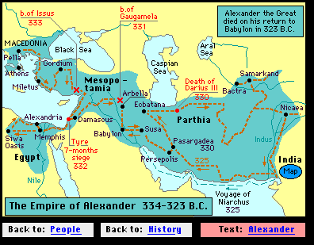
Alexander’s Empire
Notes:
*

