Slide 1
Land Forms
Unit 1

Slide 2
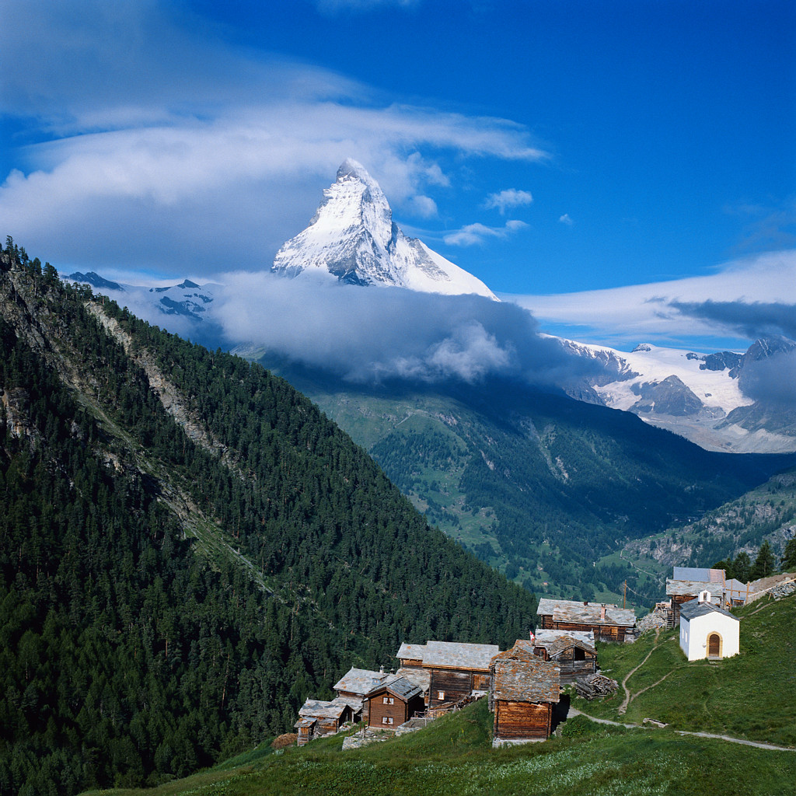
Mountain
A mountain is the highest kind of land.
A mountain has a peak.

Slide 3
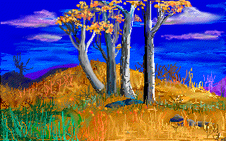
Hill
A hill is land that rises above the land around it.
A hill has a rounded top.

Slide 4
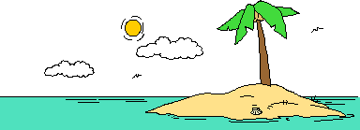
Island
An island is land that has water on all sides.

Slide 5
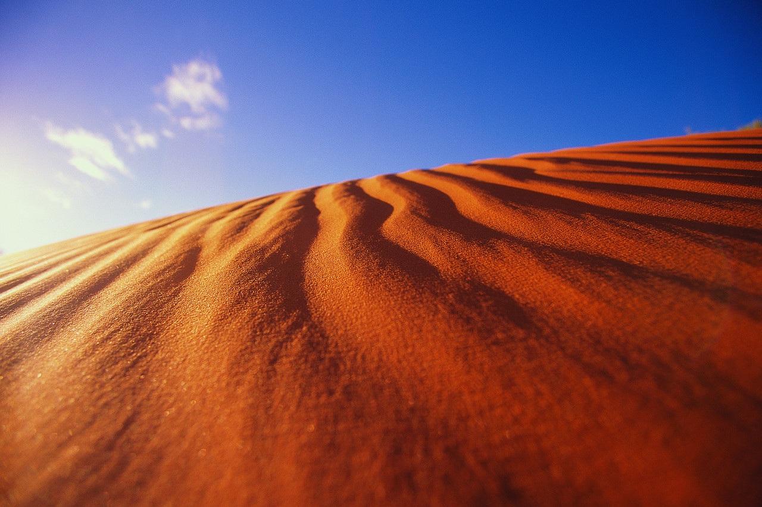
Desert
A desert is dry land with few plants.
A desert does not get much rain.

Slide 6
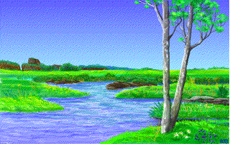
River
A river is
a long body
of water that
flows through
the land.

Slide 7
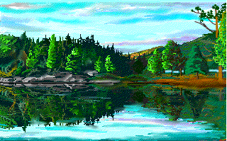
Lake
A lake is a body of water that has land on all sides.

Slide 8
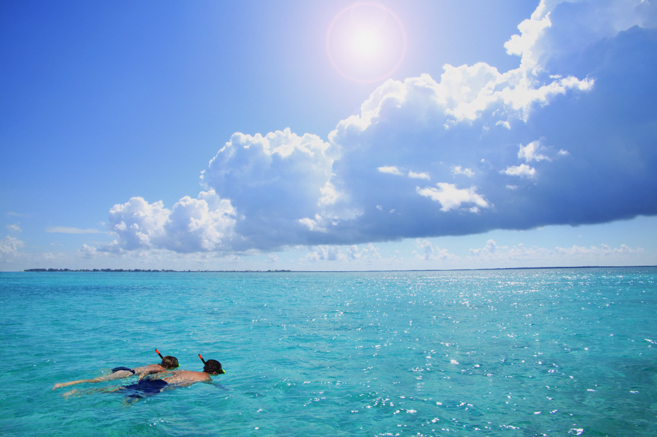
Ocean
An Ocean is a very large
body of salty water that covers a large area.

Slide 9
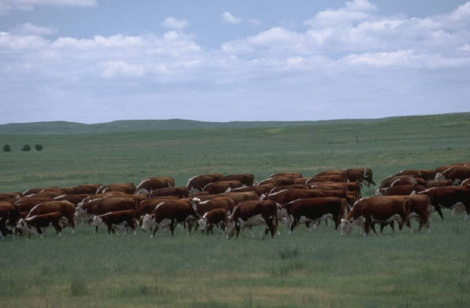
Plain
A plain is flat land.

Slide 10
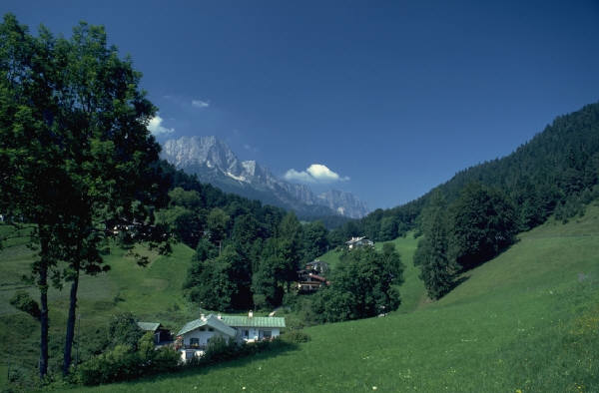
Valley
A valley is low land between hills or mountains.

Slide 11
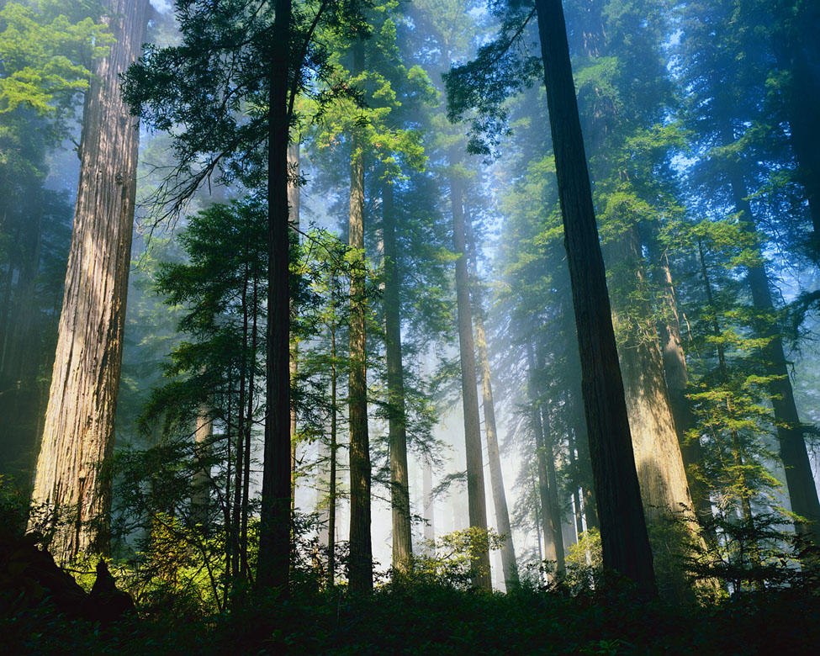
Forest
A forest is a large area of land where many trees grow.

