Slide 1
Unit 1 Map Skills

Slide 2
Symbols
Pictures that represent something.

Slide 3
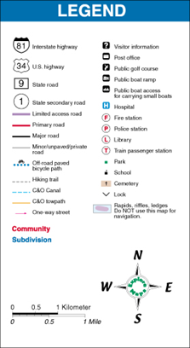
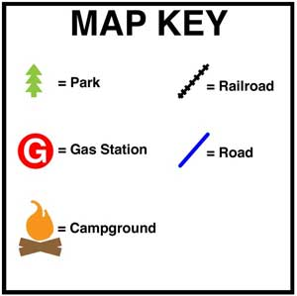
Map Key or Legend
A key or legend is an area on the map that shows us what each symbol represents.

Slide 4
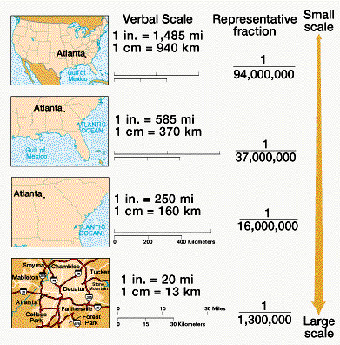
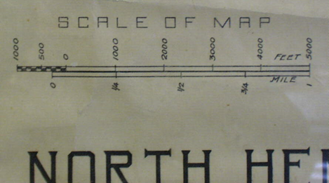
Scale
The section of the map that shows how much small the map is compared to the real area it represents.

Slide 5
Compass Rose
A symbol on map which shows the directions for a map.

Slide 6
Cardinal Directions
North
South
East
West

Slide 7
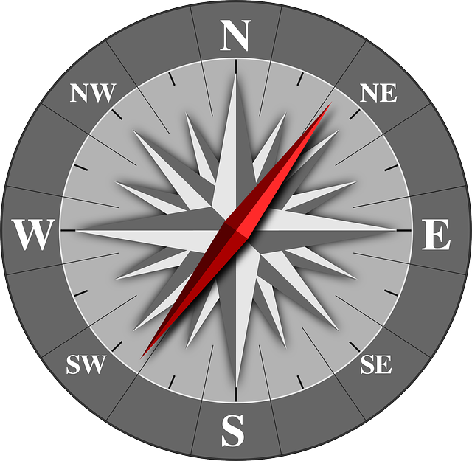
Intermediate Directions
Northeast
Southeast
Northwest
Southwest

Slide 8
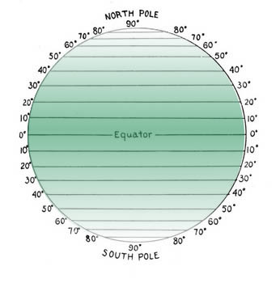
Latitude Lines (Parallels)
These lines circle the globe running EAST to WEST.
Main line of latitude is the
Equator

Slide 9
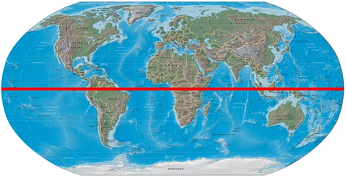
Equator
The equator is a zero degree line of latitude.
It divides the Earth into 2 hemispheres:
Northern hemisphere
Southern Hemisphere.

Slide 10
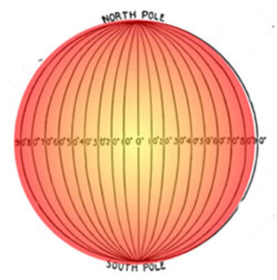
Longitude Lines
Circle the globe running NORTH to SOUTH
Can be called meridians
Main line of longitude is the
Prime Meridian

Slide 11
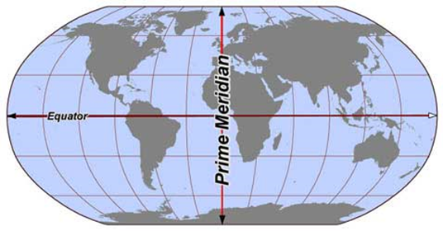
Prime Meridian
The prime meridian is the zero degree line of longitude.
Separates the EASTERN and WESTERN hemisphere.

Slide 12
Check For Understanding
1. What tool shows you what each symbol represents?
2. This shows directions North, South, East, and West.
3. What are the intermediate directions?
4. What is the main line of latitude?
5. What is the main line of longitude?
6. What is another name for longitude lines?

Slide 13
“HOW TO USE MAP SKILLS”
Step #1: Highlight the equator YELLOW, and the Prime Meridian PINK
Step #2: Draw the Compass Rose in GREEN in the bottom corner
[HINT: North, South, East, West, Northeast, Southeast, Northwest, Southwest]
Step #3: Use the lines made by the highlighted equator and Prime Meridian to label the cardinal directions on the map.
[HINT: Your lines make a giant compass. Label it like a compass in PURPLE]
Step #4: Label the FOUR hemispheres in BLUE using the intermediate directions on the inside of the quadrant on the globe.

