Slide 1
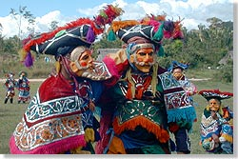
The Mayan Society
Group 2
February 23, 2007

Slide 2
Geography
Eastern third(3rd) of Mesoamerica (Mexico, Guatemala, Belize, Honduras, El Salvador); Yucatan Peninsula
Topography:
volcanic mountains-comprised highlands in south to lowlands (porous limestone shelf) in central and northern regions
Notes:
Implications that the people we call the Maya may have migrated from North America to the highlands of Guatemala perhaps as long ago as 2600 b.c. living an agricultural, village-based life.

Slide 3
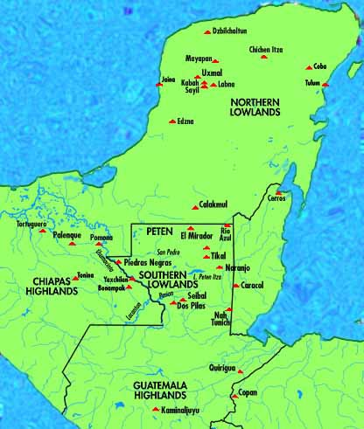
Geography Cont. - Lowlands
Southern Lowlands
Covered by a rainforest about 150 ft.
Contained: scattered savannas and swamps, or bajos
Northern Lowlands
Also comprised of forests – much drier, mainly grew small thorny trees

Slide 4
Geography Cont. – Highlands vs. Lowlands
Highlands
Climate: Much cooler and drier; fertile soil
Volcanic Highlands: Source of obsidian, jade, and other precious metals used to develop a trade
Subject to tsunamis, volcanoes, and earthquakes
Lowlands
Produced crops used for their own personal consumption (ex. Maize)
Played an important role in transportation route
Rivers (Usumacinta and Grijalva) created from the 160 in. of rainfall per year were vital to civilization as a form of transportation for both people and materials.

Slide 5
Dry Season
February – May
Characterized by intensely hot and uncomfortable air
Fields had recently been cut and had to be burned in accordance with their slash and burn for of agriculture

Slide 6
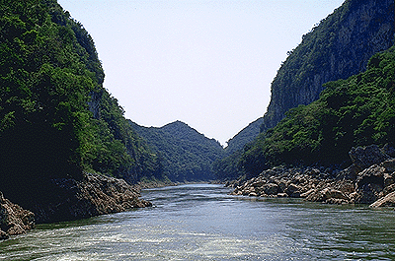
Geography Cont. – The Rivers
Series of rivers originate in the mountains and flows towards the Pacific Ocean and Gulf of Mexico.
Serve as passageways for canoes to travel from city to city
In the Classic Period: Rivers provided water for human consumption and access to trade routes
Northern Yucatan lowlands
NO MAJOR RIVERS

Slide 7
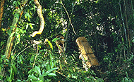
Geography Cont. – The Rain Forest
Covers the majority of Mesoamerica
Provides warmth, sunlight and water producing a variety of plants
Soil: thin and poor
For survival, plants develop highly efficient root systems that absorb nutrients from dead plants
Lowlands – stretches from northwestern Honduras through the Peten region of Guatemala and into Belize and the Chiapas

Slide 8
Geography Cont. – The Soil
Best soils found in southern highland valleys where volcanic eruptions have enriched the earth
Spring-like climate and fertile valleys have made southern highlands a popular place to settle, despite volcanic threats

Slide 9
Geography (end)
The geographical dispersion of the Mayan peoples across the region resulted in the evolution of numerous languages which are related but distinctive and prevent different Maya groups today from understanding each other
Because of the damp climate, the Mayans were unable to store their crops from year to year.

Slide 10
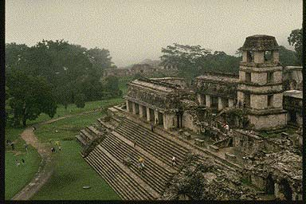
Mayan History – Classical Period
Advancement of the society
Society became more complex
Lowlands were true cities

Slide 11
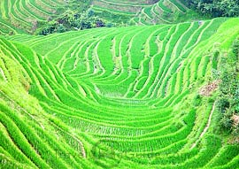
Mayan History Cont. – Classical Period
Sophisticated method of food production
Pollen records show crops that were cultivated

Slide 12
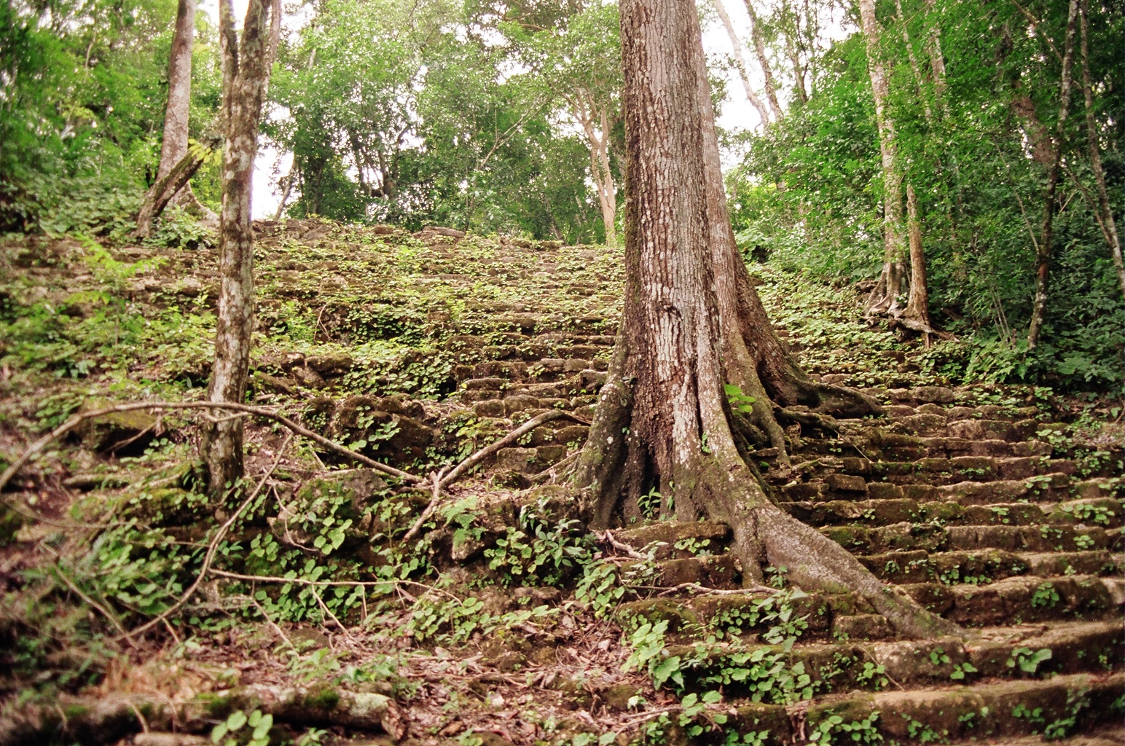
Mayan Agriculture
Permanent raised fields
Terracing
Forest Gardens
Managed Fallows
Shifting Cultivation
Wild Harvesting

Slide 13
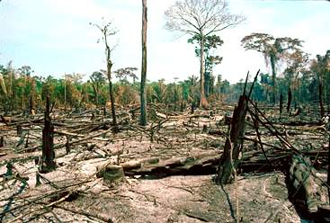
Mayan Agriculture Cont.
Mayans use slash and burn method to clear land for farming
Main food source is from farming: Mayans plant corn (maize), cacao, maguey, bananas, squash, beans, and cotton for weaving.
Used bees for honey and wax; made fermented drinks from corn, maguey and honey.
Meat was rarely eaten because it is expensive and/or hard to find.
Dogs and turkeys were the main animals kept as pets and/or food.

Slide 14
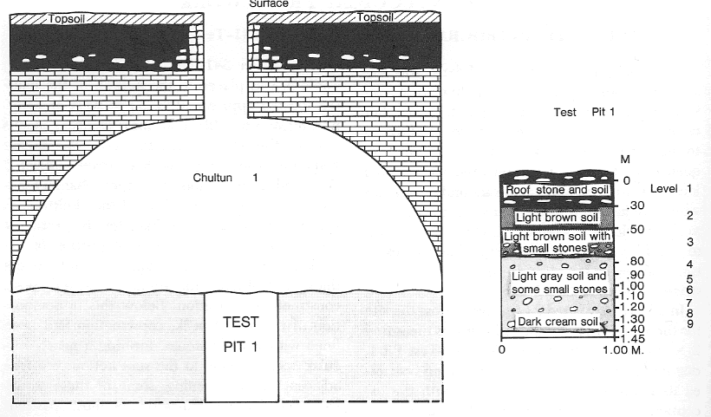
Mayan Agriculture Cont.
Underground caves called cenotes (se-NO-tes) were a vital supply of water.
Mayans learned to build underground reservoirs (chultuns) to store rainwater in places where there were no natural cenotes.
Mayans used this technique on the tropical rainforests where there was not enough ground water.

Slide 15
Maya Religion – Maya Cosmology
Horizontal Space – Quincunx-quandrant with Worldtree in center
Vertical Space – World Tree
Upperworld – 13 levels
Middleworld – where human
Underworld – 9 levels, mirror image of worlds above
Cosmology reflected in homes
Mountains and Caves
Replicated in cities

Slide 16
Mayan Religion – Fluidity of Gods
Several names for each god, like Hindu gods
Changes over time as new areas incorporated
Political events influence religion
Nagulism and Animism

Slide 17
Mayan Religion- Bloodletting and Sacrifice
Tit for tat – gods need blood
Blood as metaphor for control
Blood and pain bring vision serpent
Blood as portal deeper reality
Sacrifice of human life

Slide 18
Mayan Religion
Mayan religion had many gods.
The gods were not seen as completely good or evil.
They changed based on what desirable at that point in time.

Slide 19
Mayan Religion Cont.
Mayans believed in three major planes: the Sky, the Underworld, and the Earth.
Heaven is composed of 13 layers; various dieties live there
Much of the Mayan religion is based on cycles. For example, when to plant crops and when to call for rain.

Slide 20
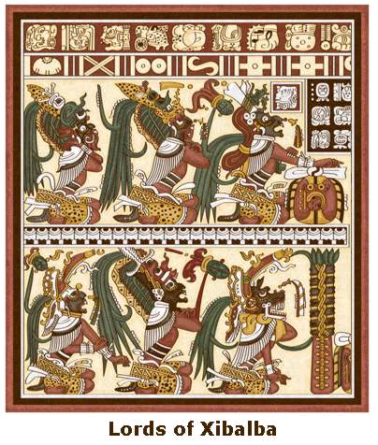
Mayan Religion Cont.
The underworld, Xibalba, is composed 9 layers.
There are gods for each layer of the Heavens and the underworld.

Slide 21
Mayan Religion Cont.
There were 13 Mayan gods of the Heavens who helped create human beings because they believed they needed subjects to worship them.

Slide 22
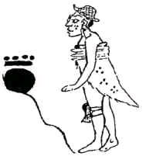
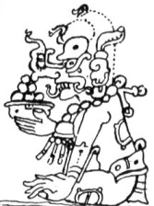
Religion: Major Gods
Hun Hunahpu – maize god
Father of the hero twins
Most important deity for the Maya
He brought about the creation for the present world age.
Chac – god of rain, thunder, and lightning
Both adored and feared by the Maya
He was portrayed as both a benefactor and a violent warrior.

Slide 23
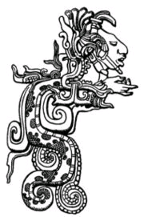
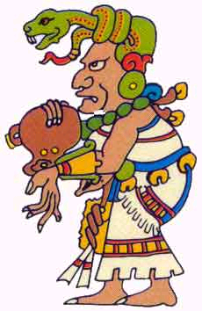
Religion: Major Gods cont.
Gukumatz – Feathered snake god
Taught the Maya the arts of civilization, including codes of law, agriculture, fishing, and medicine.
Ixchel – Earth and Moon Goddess
Goddess of creativity, weavers and childbirth, goddess of medicine and reason, and a bringer of the storms.

Slide 24
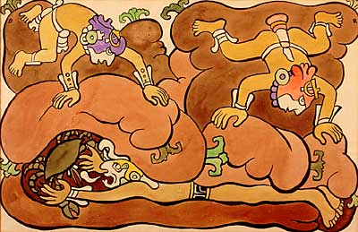
Religion: Major Gods cont.
The Hero Twins – Most famous characters in Mayan mythology.
Sun and Moon gods.
Famous for vanquishing the lords of Xibalba.

Slide 25
Calendar and Rituals
“The Maya calendar was complex and served a variety of purposes, both practical and esoteric (such as divination),” (Sharer & Traxler).
Shaman used the day a child was born in the 20-day cycle to forecast its future.
Was a source of great power for the Maya
Recorded recurring cosmological cycles, such as the sun, the moon, and Venus, some of the most important objects in the sky.
Has a point of origin, with progression creating unique days, while taking into account repeating cycles.

Slide 26
Calendar and Rituals cont.
The basic calendrical unit was the day, or k'in.
20 k'ins = 1 winal, or 20 days
18 winals = 1 tun, or 360 days
20 tuns = 1 k'atun, or 7,200 days, or 19.73 modern years
20 k'atuns = 1 bak-tun, or 144,000 days, or 394.5 modern years
20 piktuns = 1 kalabtun, or 57, 600,000 days, or 157,808.2 modern years
20 kalabtuns = 1 kinchiltun, or 1,152,000,000 days, or 3,156,164.4 modern years
20 kinchiltuns = 1 alawtun, or 23,040,000,000 days, or 63,123,287.7 modern years
These terms are used by scholars today. The actual Mayan names are only partially known.

Slide 27
Calendars and Rituals cont.
Three main calendars were used: the 260-day calendar; the 365-day year known as the Haab(18 winals, and a closing month of 5 days(Wayeb)); and the 52-year Calendar Round (a combination of the of the 260-day almanac and 365-day Haab)
The greatest cycle of time (>52 years) is known as the Long Count
The Maya were very accurate in their mathematical calculation

Slide 28
Calendars and Rituals
“The sacred almanac of 260 days determined the Maya pattern of ceremonial life and provided a basis for prophecy. The celestial deities visible as the stars, the sun, and moon guided the daily and seasonal activities of all Maya people,” (Sharer & Traxler).
“The Maya, with their essentially non-linear conception of time, held ceremonies directed to celebrate recurring temporal units,” (Sievert).
“To the ancient Maya, religious ceremonies were performed to ensure life, health, and sustenance,” (Sharer & Traxler).
Bloodletting was considered “the mortar of ancient Maya ritual life,” (Schele & Miller).

Slide 29
Calendars and Rituals cont.
Killing was an important aspect of sacrifice, using animals, slaves, children, and prisoners of war.
This would occur on important dates, when priests demanded it, or as punishment for crimes.
Mayans also performed ritual burnings in their sacrificial ceremonies. This represented human breath.
Burned copal resin along with the sacrifice, creating more smoke and a sweet smell.
Offerings to the spirits were to insure agricultural success.

Slide 30
Calendars and Rituals cont.
Offered copal, maize, squash seeds, flowers, pine boughs and needles, a fermented drink made of honey and tree bark called balche, honey, wax, rubber, cacao, virgin water, jade, obsidian, shell, and pyrite mirrors.
Small scale lower class rituals involved offering easily attainable items such as food, drink, ceramics, and copal. In upper-class rituals, items such as shells, jade, and other expensive objects were offered.

Slide 31
Mayan Sociopolitical Structure
Mayan society was split up into many distinct city-states, often warring, which usually surrounded temples
Heads of polities called halach uinics (“true men”- held most power, considered a demigod
Office was hereditary- post went from father to eldest son
Council called ah cuch cabob- included chiefs from subdivisions of cities, had veto power

Slide 32
Mayan Sociopolitical Structure
Clan society-individuals members of family primarily then of city-state
Noble class (ahmeheb) from which all officeholders were selected
Class of lower men (common workers) called yalba uinicob
Many slaves

Slide 33
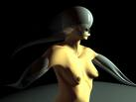
Mayan Women
Some matrilineal city-states
Powerful Lady Kwali of Tonina
Most important tasks were food preparation and child-bearing
Had some divorce righrs but difficult to access
Women prominent in religion: Moon Goddess

