Slide 1
Unit 14 The Middle Ages Visual Vocabulary
Use this PowerPoint to help you with your Vocabulary Foldable

Slide 2
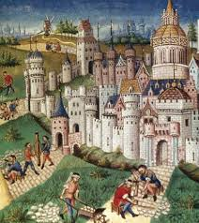
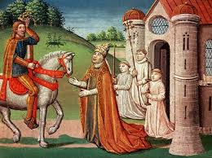
Middle Ages
The period between the fall of the Roman Empire and the modern era, from 476-1453 AD. Also called the “Middle Ages”

Slide 3
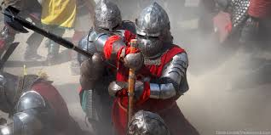
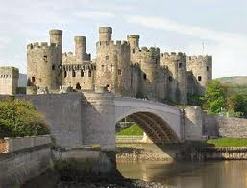
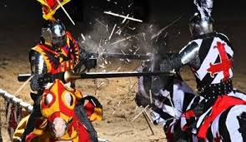
Medieval
Having to do with the period of the Middle Ages.

Slide 4
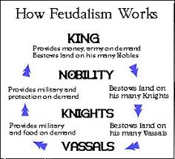
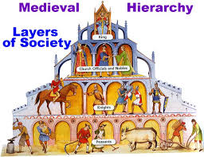
Feudalism
A political system in the Middle Ages that divided society into classes.

Slide 5
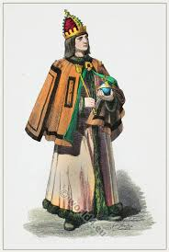
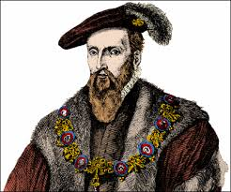
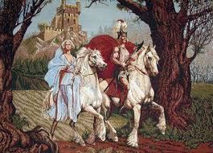
Lord
A powerful landowner

Slide 6
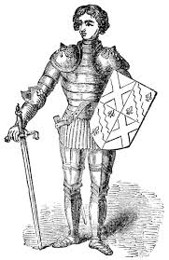
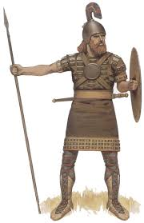
Vassal
A less wealthy noble who paid taxes to and served a lord in exchange for land.

Slide 7
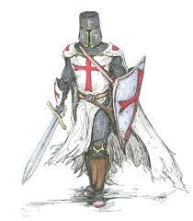
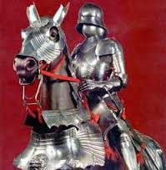
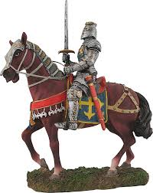
Knight
A vassal who is trained in combat who fought on behalf of lords.

Slide 8
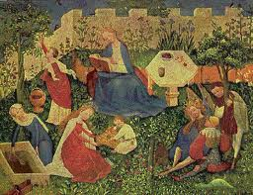
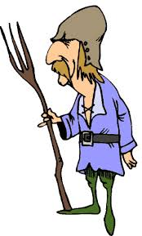
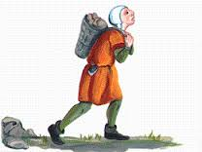
Serf
A person who lived and worked on the manor of a lord or vassal

Slide 9
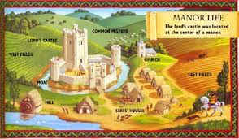
Manor
A nobles house and the villages on his land where the peasants lived.

Slide 10
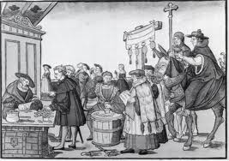
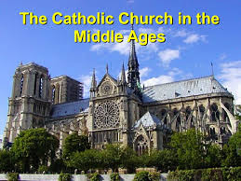
Catholic Church
Religion that spread through Europe. Was the main source of education during the Middle Ages.

Slide 11
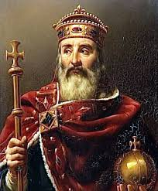
Charlemagne
A strong military leader who help control Europe after the fall of the Roman Empire

