Slide 2
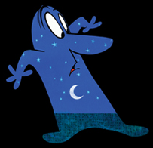
EXPOSITION – Day is messing around learning his talent. Night is sleeping.
CONFLICT – They’re not happy w/ their time of day & are jealous.
RISING ACTION – They beat each other up and show off to prove they are better than the other person.
MOVIE MOMENT: Which part of the plot do these characters’ facial expressions show?
ANSWER: The exposition when they learn about each other, and the conflict when their jealousy begins.
CLIMAX – When they stop to listen to the radio antennae…up until when they’re the same time of day
Climax
MENU
FALLING ACTION – They become the other time of day. Dance w/ each other. Play w/ new powers.
Rising Action
Falling Action
Conflict
RESOLUTION –They become satisfied & not jealous anymore.
Exposition
Resolution

Slide 3
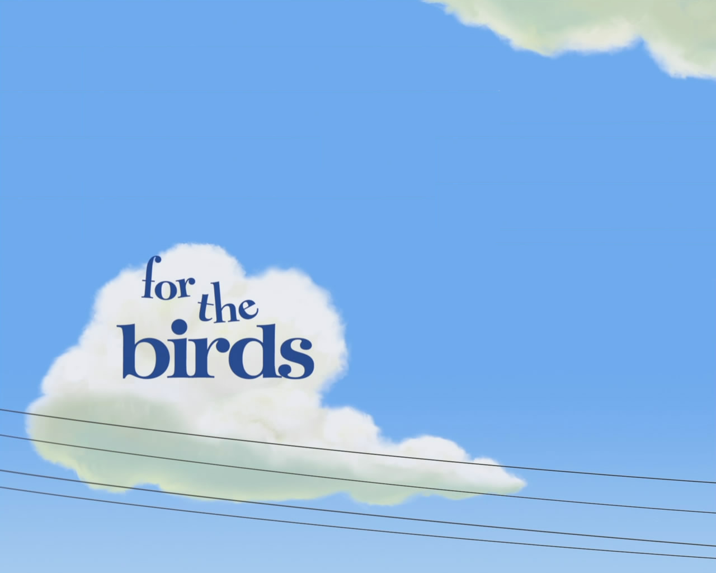
EXPOSITION – Little birds line up on the telephone line & bicker.
CLIMAX – Big bird’s last finger slips off the telephone line.
CONFLICT – Little birds mock awkward bird & exclude the outsider.
FALLING ACTION – Little birds all fall naked. Big bird laughs.
RISING ACTION – Big bird lands between them. Little birds peck his fingers to knock him off line.
RESOLUTION – Little naked birds all run and hide safely behind the bird they mocked earlier.
MOVIE MOMENT: How does this movie screenshot tell us what time in history this story happens?
Climax
MENU
ANSWER: The story had to happen after telephone lines were invented and strung up across the country.
Rising Action
Falling Action
Conflict
Exposition
Resolution

Slide 4
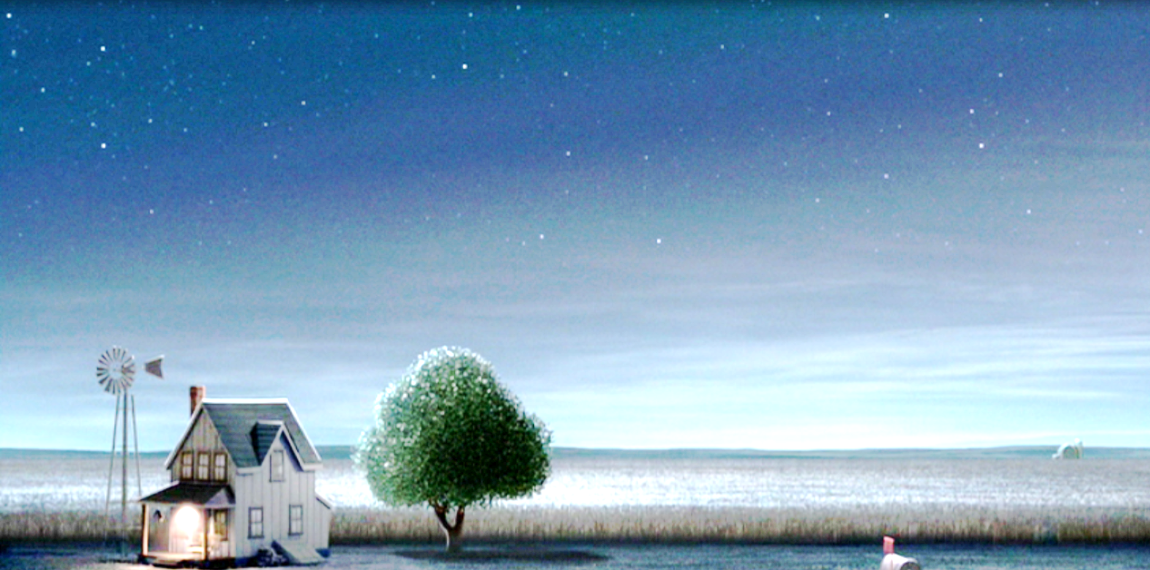
EXPOSITION – Quiet fields & house, sleeping boy starts lifting
LIFTED
CONFLICT – Alien-in-training doesn’t know how to “lift”
MOVIE MOMENT: In the exposition, what does the mood of this farm setting feel like before the aliens arrive?
MENU
RISING ACTION – Alien boy gets more and more frustrated with his inability to “lift”
ANSWER: The feeling is calm and sleepy, the porch swing gently swinging, the weathercock shifting softly in the breeze.
CLIMAX – Alien boy gets cocky and human boy falls through hole in ship
Climax
FALLING ACTION – Alien teacher fixes everything in the house and lets alien boy drive the spaceship
RESOLUTION – Alien boy crashes spaceship and human boy is left “lifted” on a giant spire in a canyon
Rising Action
Falling Action
Conflict
Exposition
Resolution

Slide 5
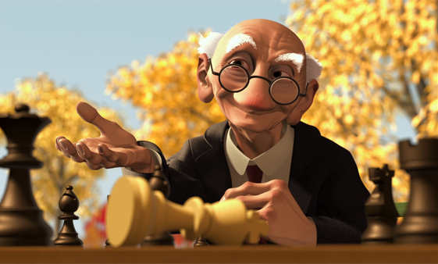
Geri’s
EXPOSITION – Geri sits down at a table in the park and sets up chess.
MENU
game
CONFLICT – Nobody is at the park to play chess w/ Geri.
MOVIE MOMENT: After Geri has won the chess game, why does he ask for his teeth back?
RISING ACTION – Laughing Geri takes all Geri’s pieces, and it looks like he’s going to win.
ANSWER: He lost his teeth to himself last time he played, and he was hoping he’d win so he could earn them back.
CLIMAX – Geri fakes a heart attack, flips the board around, and gets away with his trick.
Climax
FALLING ACTION – Laughing Geri realizes he’s losing. Geri sits back and smiles.
Rising Action
Falling Action
RESOLUTION – Geri wins his teeth back from himself (apparently, he lost them last time he played himself).
Conflict
Exposition
Resolution

Slide 6
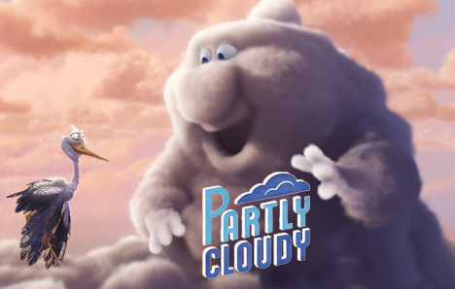
EXPOSITION – Storks in Cloudland; Storks deliver the baby animals. Stork wants to deliver animals.
MOVIE MOMENT: How does this movie still epitomize how Nimbus feels about his job?
ANSWER: Nimbus loves his job, but even more, he wants to feel wanted. This moment is when he sees that stork isn’t going to leave.
Climax
CONFLICT – Stork’s Nimbus cloud only makes dangerous animals.
RISING ACTION – Stork delivers Crocodile, Ram, Porcupine, Shark. Then leaves to go be with happy Cumulous Cloud.
Rising Action
Falling Action
Conflict
Exposition
Resolution
CLIMAX – Nimbus gets mad (lightning) and cries (rain). Stork returns and puts on protective gear.
FALLING ACTION – Nimbus hugs Stork. Nimbus makes an electric eel, which shocks Stork.
RESOLUTION – Stork and Nimbus work together forever making & delivering animals.
MENU

Slide 7
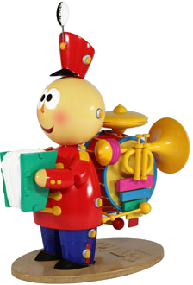
EXPOSITION – Baby enters room and starts playing with toys. Tin Toy is ready to be played with.
MENU
CONFLICT – Baby scares Tin Toy by smashing the other toys.
RISING ACTION – Tin Toy runs away from Baby. Other toys under couch. Baby falls and starts crying.
MOVIE MOMENT: In this exposition movie still, what emotions are on Tin Toy’s face?
ANSWER: Hope and expectation that he’ll be a good toy for the toddler.
CLIMAX – Baby’s crying and Tin Toy goes out to cheer baby up. Baby grabs Tin Toy and gets happy.
Climax
FALLING ACTION – Baby finds the box, starts playing w/ the box and the bag.
Rising Action
Falling Action
RESOLUTION – Tin Toy can’t get Baby’s attention because Baby’s playing with the bag.
Conflict
Exposition
Resolution

Slide 8
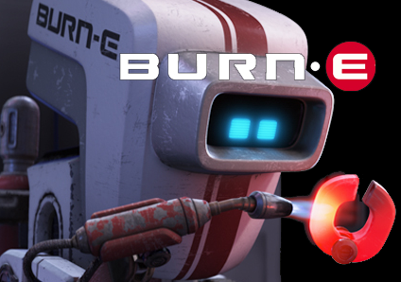
EXPOSITION – Burn-E is a welding robot who really wants to do his job.
MENU
CONFLICT – A meteor strikes a light in his job sector.
RISING ACTION – He tries & tries to fix the light but things keep going wrong. The ship flies back to Earth.
MOVIE MOMENT: In this Rising Action movie still, how does it show us Burn-E’s inner person?
ANSWER: He is a soft, sensitive robot that would make flower shapes and wants to do his job.
CLIMAX – Burn-E finds Supply-R & finally pushes the power button.
Climax
FALLING ACTION – The lid flies through the air toward the ship.
Rising Action
Falling Action
Conflict
RESOLUTION – The lid smashes into the light again. Burn-E faints.
Exposition
Resolution

Slide 9
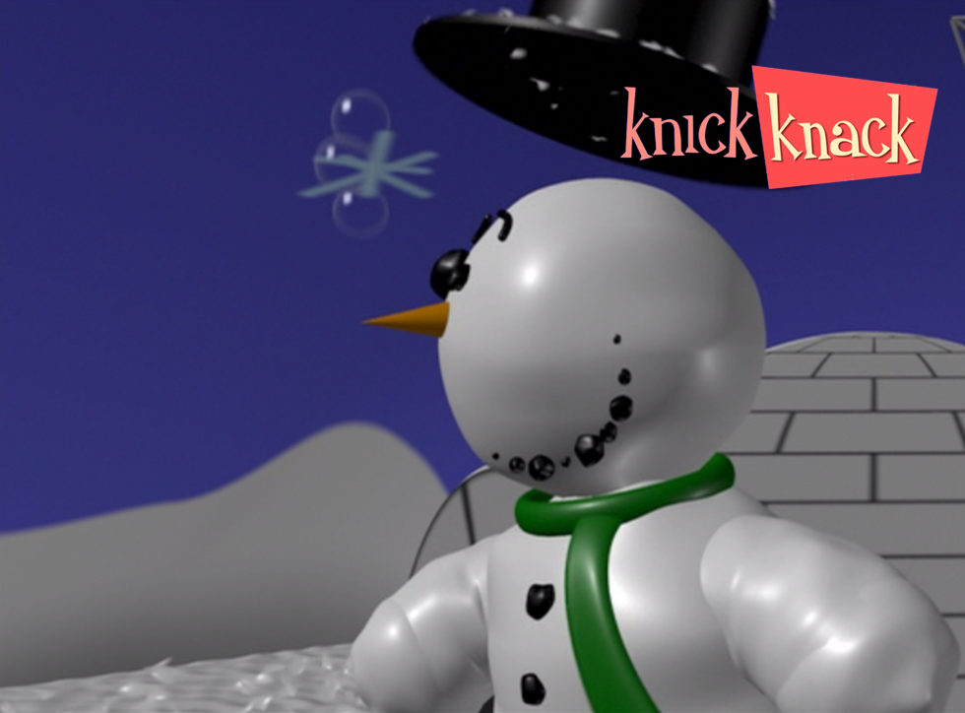
EXPOSITION – We see all the different tropical toys and locations. Bikini girl waves at Snowman.
CONFLICT – Snowman wants bikini girl, but he’s stuck in snow globe.
MOVIE MOMENT: How does the look on Snowman’s face show how far he’s willing to go to overcome the conflict?
RISING ACTION – Snowman tries everything to get out of the snow globe.
MENU
ANSWER: He is so excited that he’ll do anything to get out of the snow globe.
CLIMAX – Snowman climbs out of snow globe, falls into fish tank, and sees Mermaid.
Climax
FALLING ACTION – Snow globe falls down on him.
Rising Action
Falling Action
RESOLUTION – Snowman is stuck in snow globe again and can’t have Mermaid or Bikini girl.
Conflict
Exposition
Resolution

Slide 10
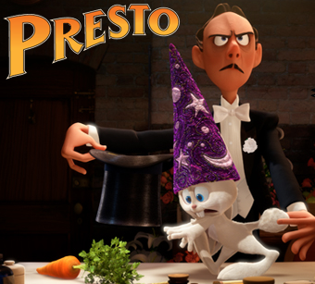
EXPOSITION – We meet magician & rabbit about to perform. Rabbit is hungry.
CONFLICT – Rabbit wants carrot, but magician won’t give it to him unless he performs.
MOVIE MOMENT: How do the magician’s & rabbit’s facial expressions illustrate the conflict?
RISING ACTION – Magician keeps trying all kinds of tricks, but the rabbit gets revenge on him each time. The audience loves the slapstick show.
MENU
ANSWER: The magician wants the rabbit to do its job for him, while the rabbit is distraught that the magician won’t give him his carrot.
Climax
CLIMAX – Magician is falling from the ceiling and will die if the rabbit doesn’t pull a trick out of his hat to save him.
FALLING ACTION – The audience loves the show and applauds.
Rising Action
Falling Action
Conflict
RESOLUTION – Magician realizes rabbit did a great job and makes peace, gives him carrot.
Exposition
Resolution

Slide 11
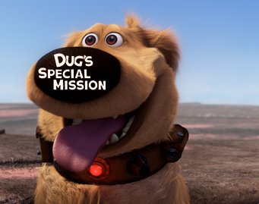
EXPOSITION – Dug is a talking dog. It is his birthday. He loves special missions. He made a wish.
MENU
CONFLICT – The mean dogs want to ruin Dug’s birthday.
RISING ACTION – All of the mean dogs’ tricks end up hurting them instead of Dug.
MOVIE MOMENT: How does this movie screenshot tell us what time in history this story happens?
Climax
CLIMAX – The mean dogs call their master. They say Dug is a bad dog.
ANSWER: Talking dog collars are something from the future.
FALLING ACTION – Dug finds the old man. He gets a new master.
Rising Action
Falling Action
Conflict
RESOLUTION – Dug speaks and surprises the boy and the old man.
Exposition
Resolution

