Slide 1
Using Colorful Language

Slide 2
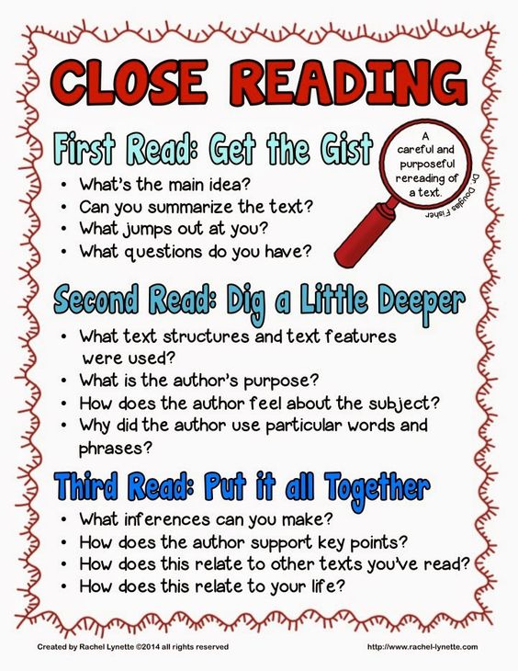
Review

Slide 3
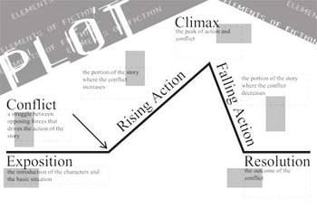
When do we use colorful language?
Soon we will start our narrative writing

Slide 4
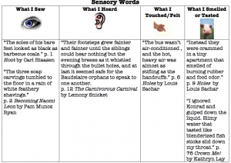
Did you describe everything?

Slide 5
Examples
The room where I found myself was thick with dust, musty and empty of all furniture. Spiders had erected great stretchings of their web about the fireplace. I made my way quickly to the hall, threw open the door of the room where the box was and paused on the threshold. It was a dark morning and the weather had stained the windows with blears of grey wash which kept the brightest part of the weak light from coming in. The far corner of the room was a blur of shadow. I had a sudden urge to have done with my task and be out of this house forever.
Flann O’Brien

